Slide 1

A Recipe for adaptive hp-fems
Adam Blakey
Blakey Bakery Co.

Slide 2





Today’s Menu
Appetiser
  Introductory analysis
A quick snack
  Interactive example
Sorbet
  C++ implementation
  Numerical experiments
Main course
  hp-adaptive FEMs in action
Pudding
  Future work

Slide 3

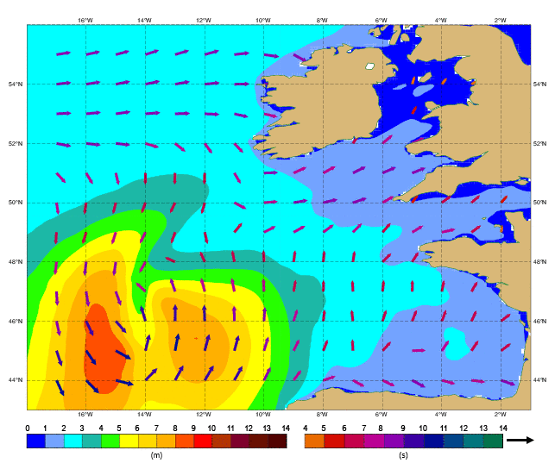
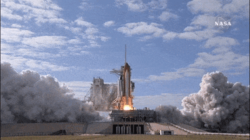
The Appetiser
Why FEMs?
Differential equations are vital to understanding our universe:
Fluid flow
Weather prediction
Space flight
Few have analytical solutions:
Finite differences
Finite volumes
Finite element methods
[Karl Sims]
[NASA]
[ECMWF]

Slide 4


The Appetiser
Regular mesh
FEM Properties
We generally choose FEMs over other methods thanks to their:
Geometric flexibility
Adaptivity and error control
Optimal (high) orders of convergence
Irregular mesh [Hans Petter Langtangen]

Slide 5
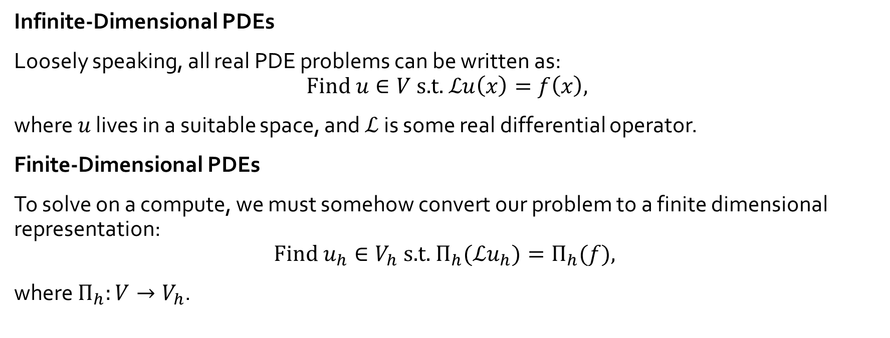
The Appetiser
PDEs
Infinite-Dimensional PDEs
Loosely speaking, all real PDE problems can be written as:
$$\text{Find} u∈V \text{s}\text{.}\text{t}\text{. }ℒu\left(x\right)=f\left(x\right),$$
where $u$ lives in a suitable space, and $ℒ$ is some real differential operator.
Finite-Dimensional PDEs
To solve on a compute, we must somehow convert our problem to a finite dimensional representation:
$$\text{Find} u_{h}∈V_{h} \text{s}\text{.}\text{t}\text{. }Π_{h}(ℒu_{h})=Π_{h}(f),$$
where $Π_{h}:V→V_{h}$.

Slide 6
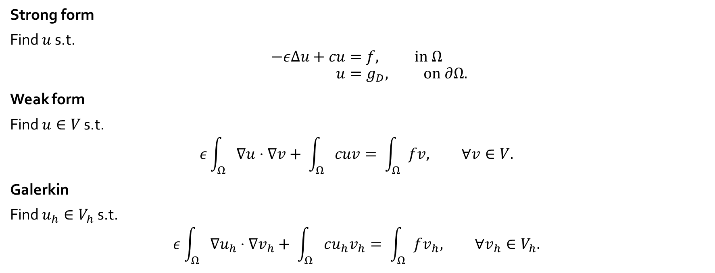
The Appetiser
Model Problem
Strong form
Find $u$ s.t.
$$−εΔu+cu=f, \text{in} Ω \\ u=g_{D}, \text{on} ∂Ω.$$
Weak form
Find $u∈V$ s.t.
$$ε\int_{Ω}{∇u⋅∇v+ \int_{Ω}{cuv= \int_{Ω}{fv, ∀v∈V.}}}$$
Galerkin
Find $u_{h}∈V_{h}$ s.t.
$$ε\int_{Ω}{∇u_{h}⋅∇v_{h}+ \int_{Ω}{cu_{h}v_{h}= \int_{Ω}{fv_{h}, ∀v_{h}∈V_{h}.}}}$$

Slide 7
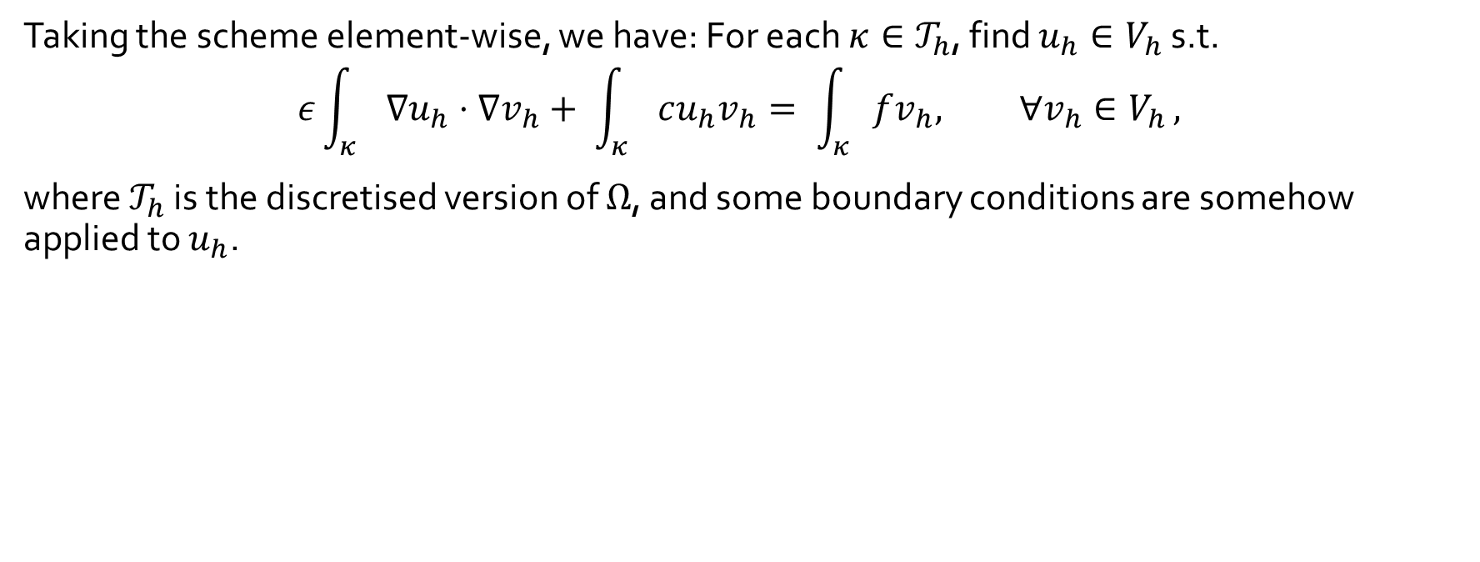
The Appetiser
CG-FEM
Taking the scheme element-wise, we have: For each $κ∈𝒯_{h}$, find $u_{h}∈V_{h}$ s.t.
$$ε\int_{κ}{∇u_{h}⋅∇v_{h}+ \int_{κ}{cu_{h}v_{h}= \int_{κ}{fv_{h}, ∀v_{h}∈V_{h}}},}$$
where $𝒯_{h}$ is the discretised version of $Ω$, and some boundary conditions are somehow applied to $u_{h}$.
Notes:
Note that for CG-FEM we will assume that boundary conditions are strongly imposed.

Slide 8

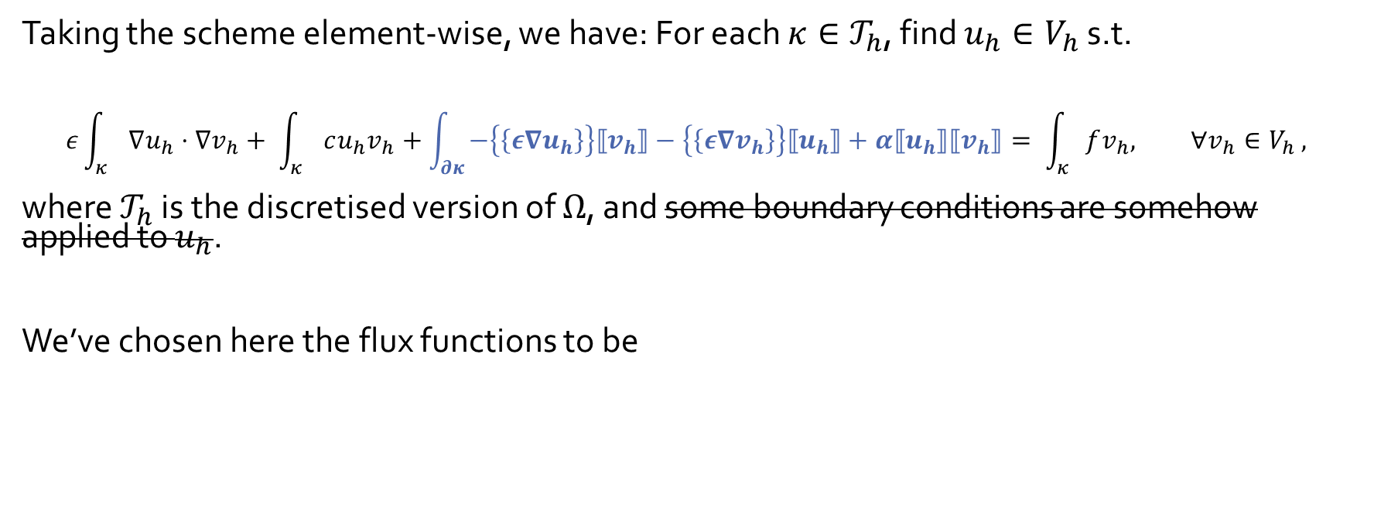
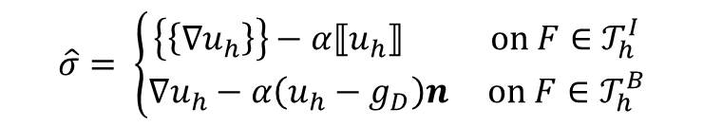
The Appetiser
DG-FEM
Taking the scheme element-wise, we have: For each $κ∈𝒯_{h}$, find $u_{h}∈V_{h}$ s.t.
$$ε\int_{κ}{∇u_{h}⋅∇v_{h}+ \int_{κ}{cu_{h}v_{h}+\int_{∂κ}{−\left\{\left\{ε∇u_{h}\right\}\right\}⟦v_{h}⟧−\left\{\left\{ε∇v_{h}\right\}\right\}⟦u_{h}⟧+α⟦u_{h}⟧⟦v_{h}⟧}= \int_{κ}{fv_{h}, ∀v_{h}∈V_{h}}},}$$
where $𝒯_{h}$ is the discretised version of $Ω$, and some boundary conditions are somehow applied to $u_{h}$.
We’ve chosen here the flux functions to be
$$\hat{u}= \left\{\begin{aligned}\left\{\left\{u_{h}\right\}\right\} \text{on} F∈𝒯_{h}^{I} \\ g_{D} \text{on} F∈𝒯_{h}^{B}\end{aligned}\right.$$
$$\hat{σ}= \left\{\begin{aligned}\left\{\left\{∇u_{h}\right\}\right\}−α⟦u_{h}⟧ \text{on} F∈𝒯_{h}^{I} \\ ∇u_{h}−α\left(u_{h}−g_{D}\right)n \text{on} F∈𝒯_{h}^{B}\end{aligned}\right.$$
Specifically speaking, we will use the Symmetric Interior Penalty scheme.
Notes:
DG = CG with weakly-imposed boundary conditions
Hybrid FVM and CG-FEM
Fluxes and high-order polynomials => can, for example, conserve certain laws for fluxes
Fluxes give a way to communicate between elements
For polygonal elements, no useful CG alternative
CG bad for advection

Slide 9
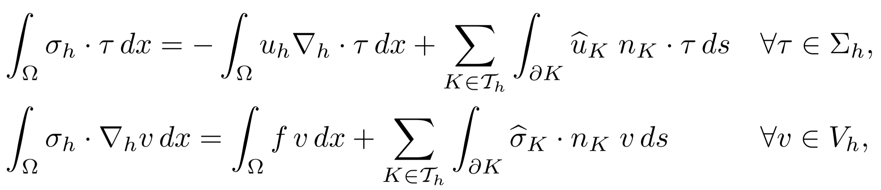
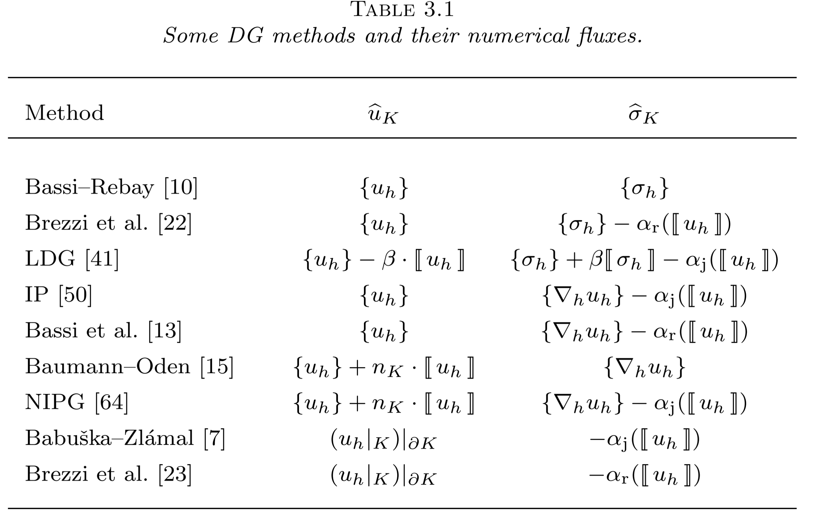
The Appetiser
DG-FEM
[Arnold et al, 2001]

Slide 10

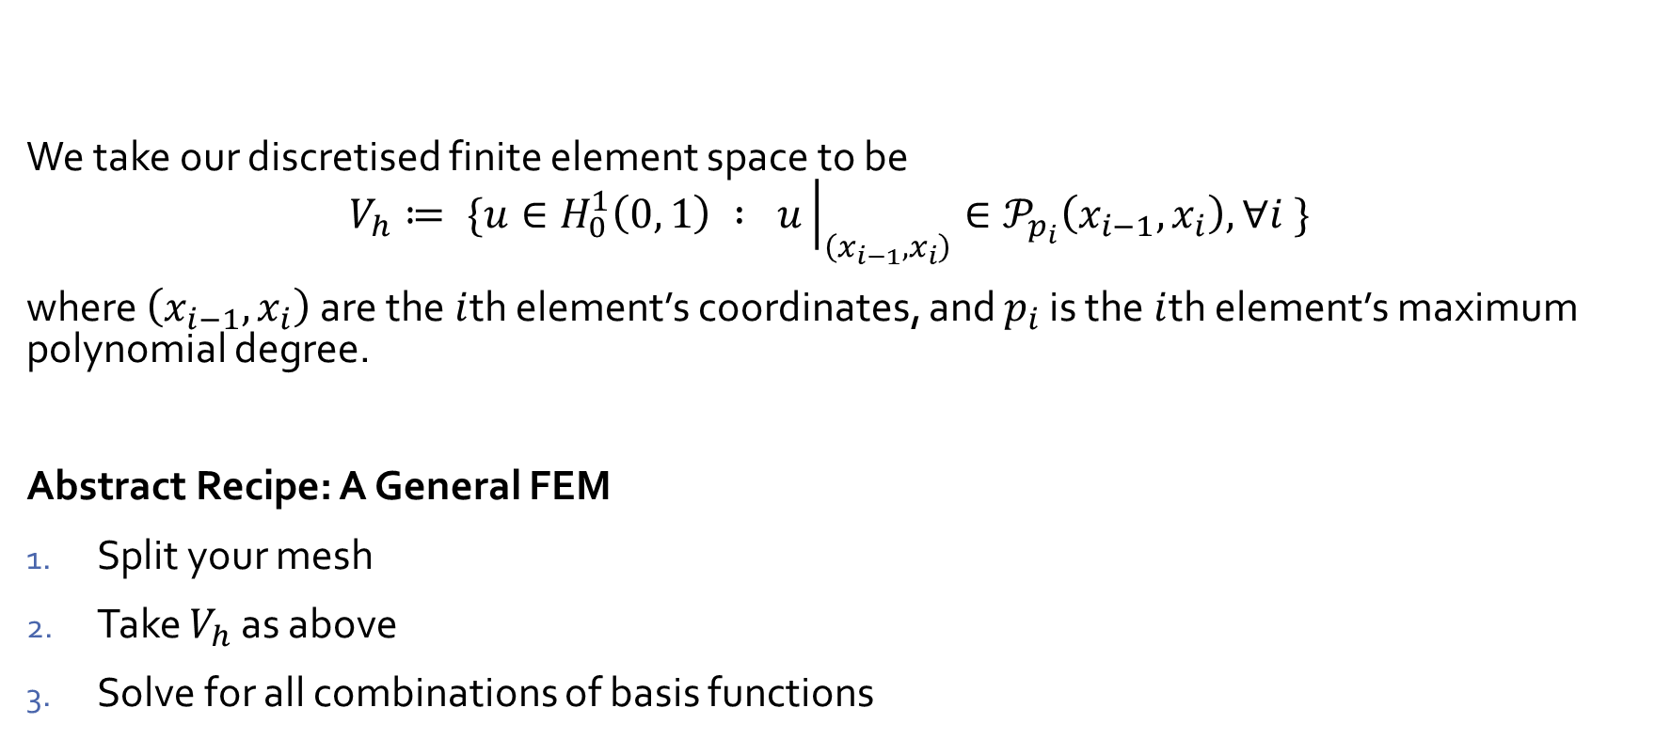
The Appetiser
Construction of $V_{h}$ in 1D
We take our discretised finite element space to be
$$V_{h}≔ \{u∈H_{0}^{1}\left(0, 1\right) : u{\left.​\right|}_{\left(x_{i−1},x_{i}\right)}∈𝒫_{p_{i}}\left(x_{i−1},x_{i}\right), ∀i \}$$
where $\left(x_{i−1},x_{i}\right)$ are the $i$th element’s coordinates, and $p_{i}$ is the $i$th element’s maximum polynomial degree.
Abstract Recipe: A General FEM
Split your mesh
Take $V_{h}$ as above
Solve for all combinations of basis functions

Slide 11
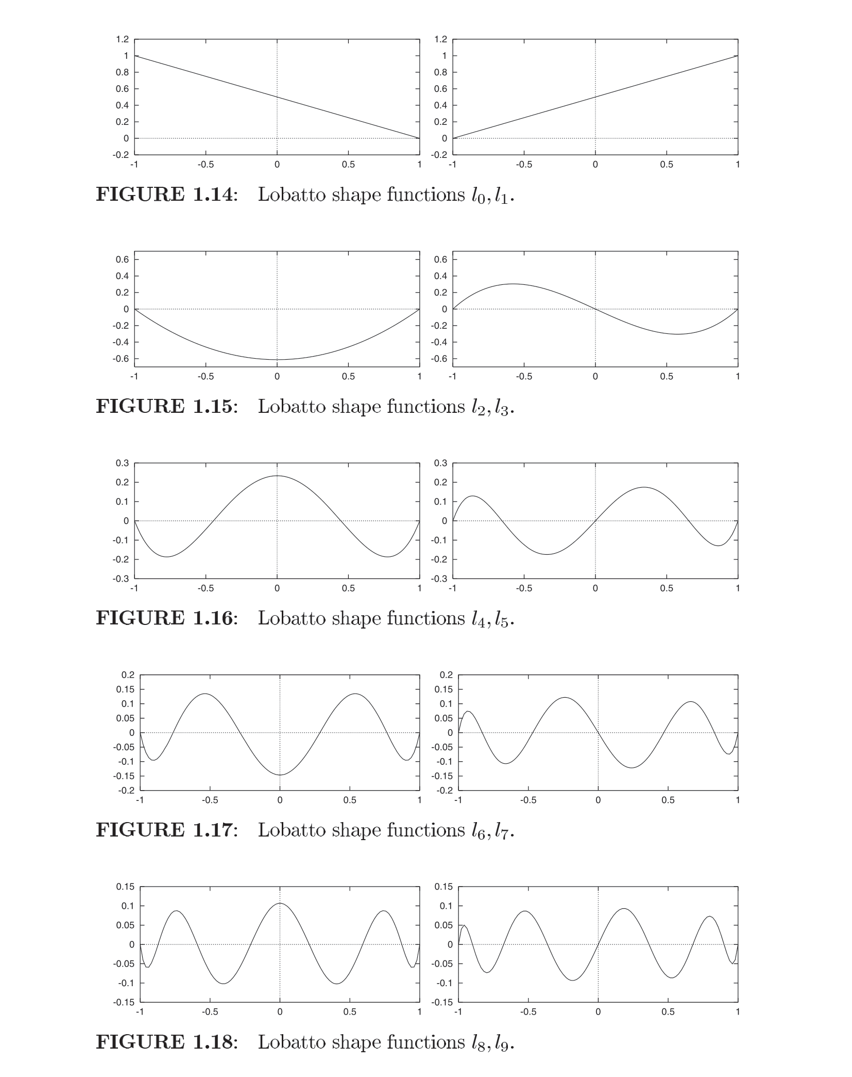
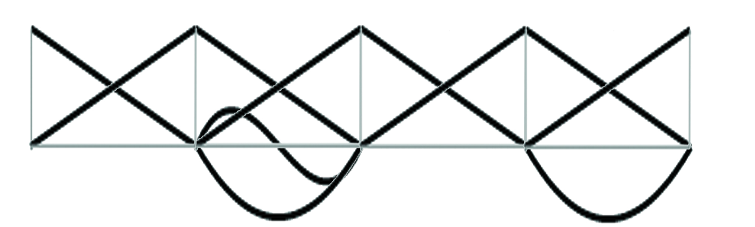

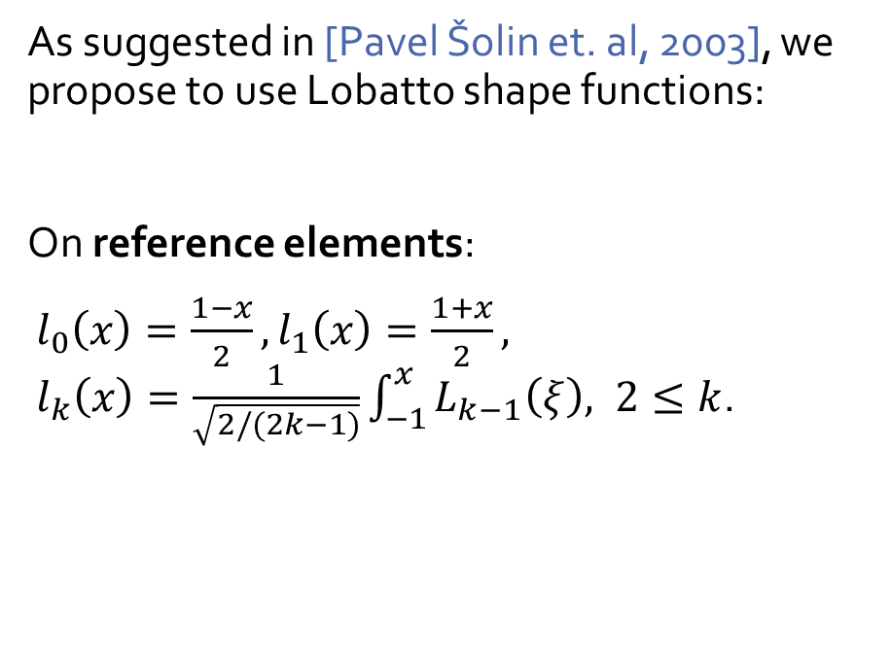



The Appetiser
Basis Functions
Lobatto shape functions
[Pavel Šolin et. al, 2003]
As suggested in [Pavel Šolin et. al, 2003], we propose to use Lobatto shape functions:
On reference elements:
$l_{0}\left(x\right)=\frac{1−x}{2}, l_{1}\left(x\right)=\frac{1+x}{2},$
$l_{k}\left(x\right)=\frac{1}{\sqrt{2/(2k−1)}}\int_{−1}^{x}{L_{k−1}\left(ξ\right), 2≤k}$.
$$p=1$$
$$p=3$$
$$p=1$$
$$p=2$$
Notes:
REFERENCE ELEMENTS

Slide 12
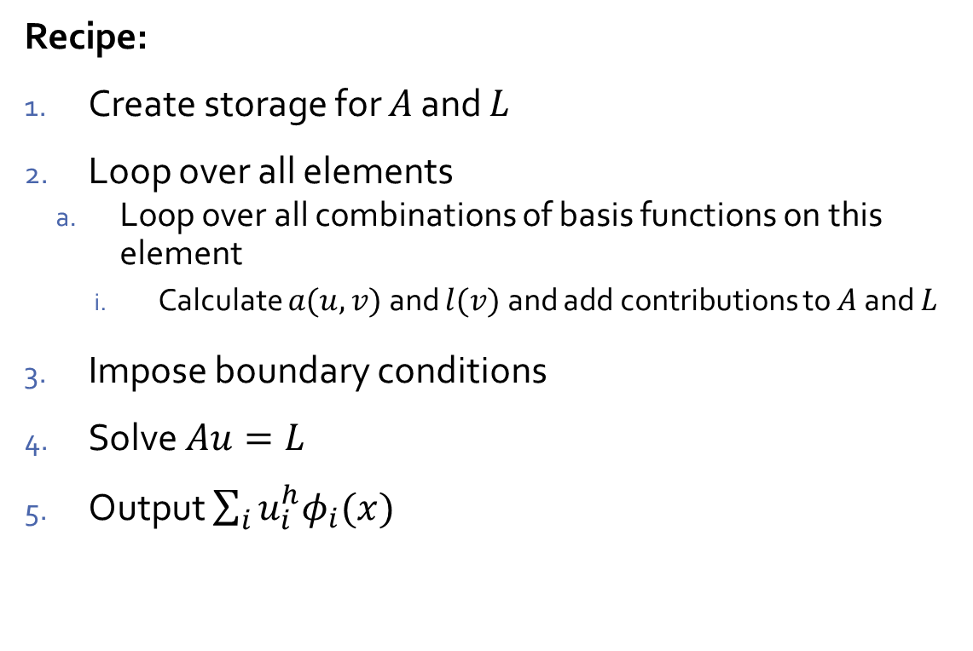
The Appetiser
Linear PDE CG-FEM Procedure
Ingredients:
Elements in a mesh
Choice of basis functions
Linear solver
Recipe:
Create storage for $A$ and $L$
Loop over all elements
  Loop over all combinations of basis functions on this element
    Calculate $a(u, v)$ and $l(v)$ and add contributions to $A$ and $L$
Impose boundary conditions
Solve $Au=L$
Output $\sum_{i}{u_{i}^{h}φ_{i}(x)}$

Slide 13
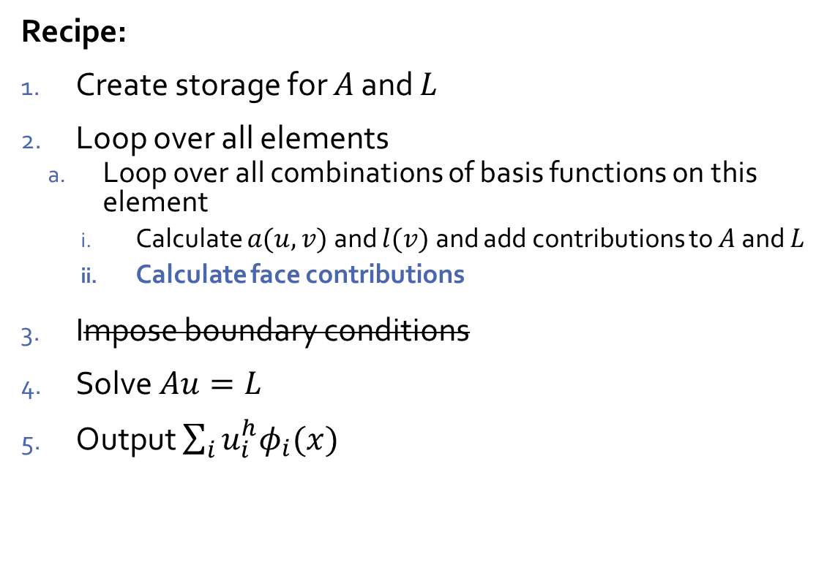
The Appetiser
Linear PDE DG-FEM Procedure
Ingredients:
Elements in a mesh
Faces between elements
Penalisation parameter
Choice of basis functions
Linear solver
Recipe:
Create storage for $A$ and $L$
Loop over all elements
  Loop over all combinations of basis functions on this element
    Calculate $a(u, v)$ and $l(v)$ and add contributions to $A$ and $L$
    Calculate face contributions
Impose boundary conditions
Solve $Au=L$
Output $\sum_{i}{u_{i}^{h}φ_{i}(x)}$
Specifically speaking, we will use the Symmetric Interior Penalty scheme.

Slide 14
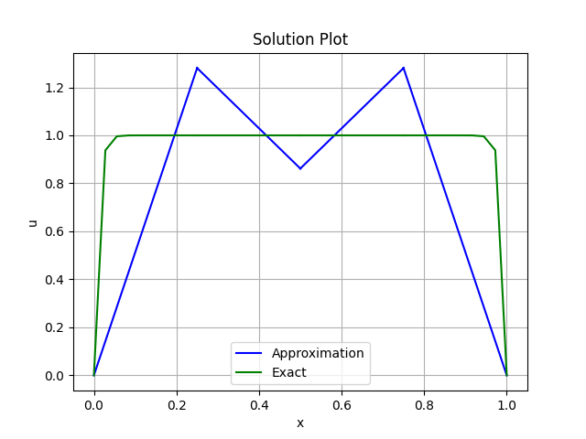
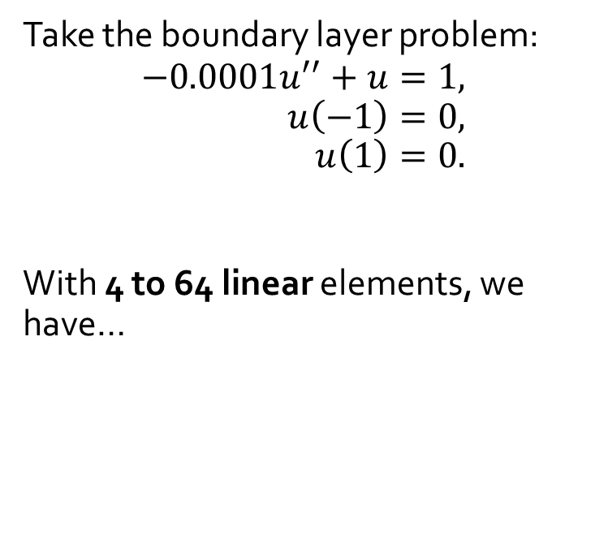
The Appetiser
Some Motivating Examples
Take the boundary layer problem:
$$−0.0001u^{′′}+u=1, \\ u\left(−1\right)=0, \\ u\left(1\right)=0.$$
With 4 to 64 linear elements, we have…

Slide 15
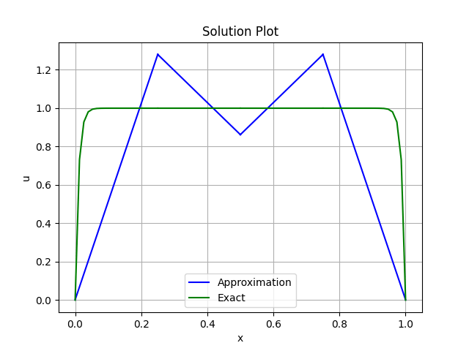
The Appetiser
Some Motivating Examples
DG-FEM
CG-FEM

Slide 16
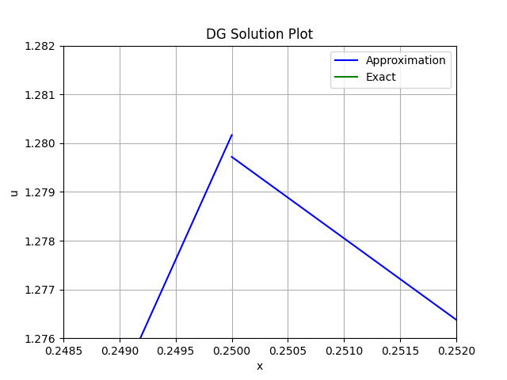
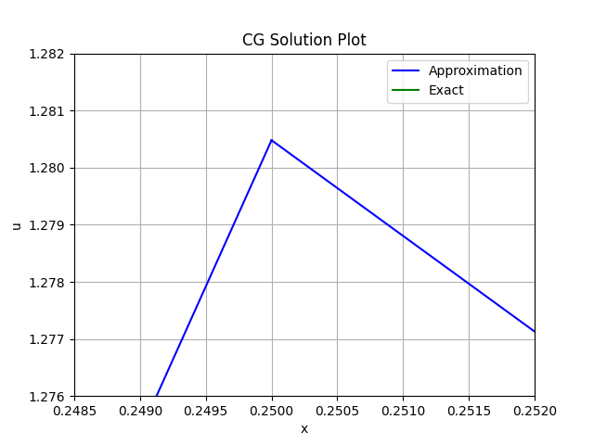
The Appetiser
Some Motivating Examples
DG-FEM
CG-FEM

Slide 17

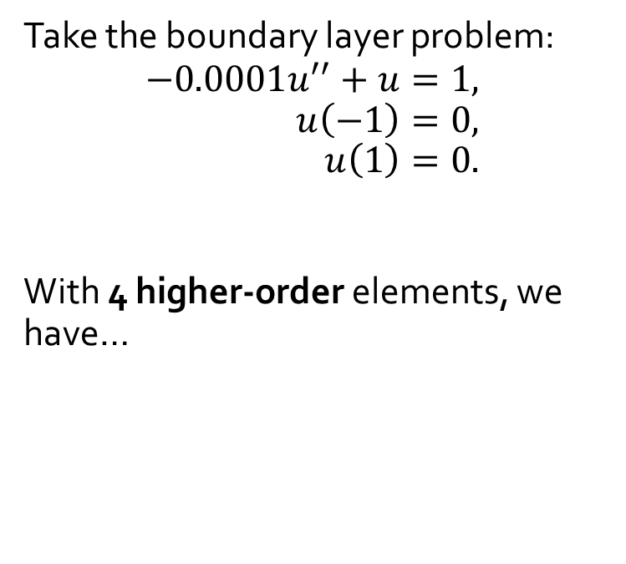
The Appetiser
Some Motivating Examples
Take the boundary layer problem:
$$−0.0001u^{′′}+u=1, \\ u\left(−1\right)=0, \\ u\left(1\right)=0.$$
With 4 higher-order elements, we have…

Slide 18
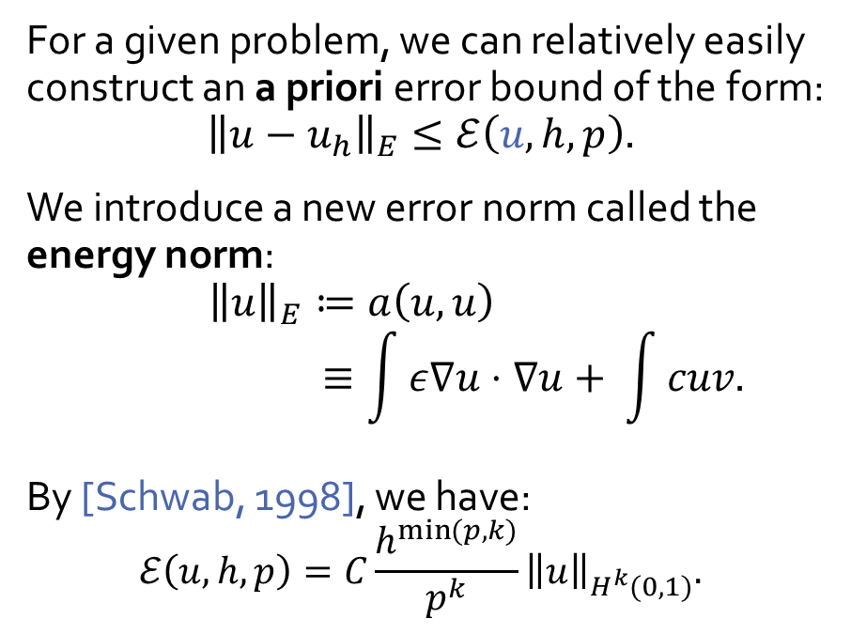
The Appetiser
A Priori Error Analysis for CG
For a given problem, we can relatively easily construct an a priori error bound of the form:
$${\left\|u−u_{h}\right\|}_{E}≤ℰ\left(u, h, p\right).$$
We introduce a new error norm called the energy norm:
$${\left\|u\right\|}_{E}≔a\left(u,u\right) \\ ≡\int{ε∇u⋅∇u+ \int{cuv.}}$$
By [Schwab, 1998], we have:
$$ℰ\left(u, h, p\right)=C\frac{h^{\min{(p,k)}}}{p^{k}}{\left\|u\right\|}_{H^{k}(0,1)}.$$
For DG, we refer to
[Castillo et al, 2007]
Notes:
Very specific to 1D.
What is k?

Slide 19
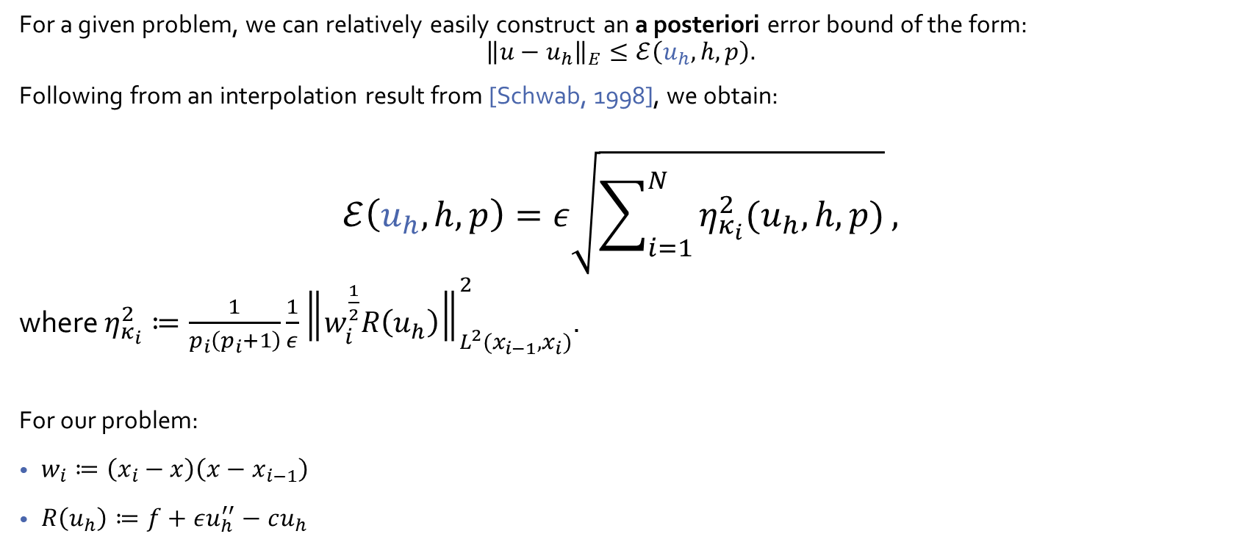
The Appetiser
A Posteriori Error Analysis for CG
For a given problem, we can relatively easily construct an a posteriori error bound of the form:
$${\left\|u−u_{h}\right\|}_{E}≤ℰ\left(u_{h}, h, p\right).$$
Following from an interpolation result from [Schwab, 1998], we obtain:
$$ℰ\left(u_{h}, h, p\right)=ε\sqrt{\sum_{i=1}^{N}{η_{κ_{i}}^{2}(u_{h}, h, p)}},$$
where $η_{κ_{i}}^{2}≔\frac{1}{p_{i}\left(p_{i}+1\right)}\frac{1}{ε}{\left\|w_{i}^{\frac{1}{2}}R\left(u_{h}\right)\right\|}_{L^{2}(x_{i−1}, x_{i})}^{2}$.
For our problem:
$w_{i}≔\left(x_{i}−x\right)\left(x−x_{i−1}\right)$
$R\left(u_{h}\right)≔f+εu_{h}^{′′}−cu_{h}$
For DG, we refer to
[Houston et al, 2007]
Notes:
Residual a posteriori error bound.

Slide 20
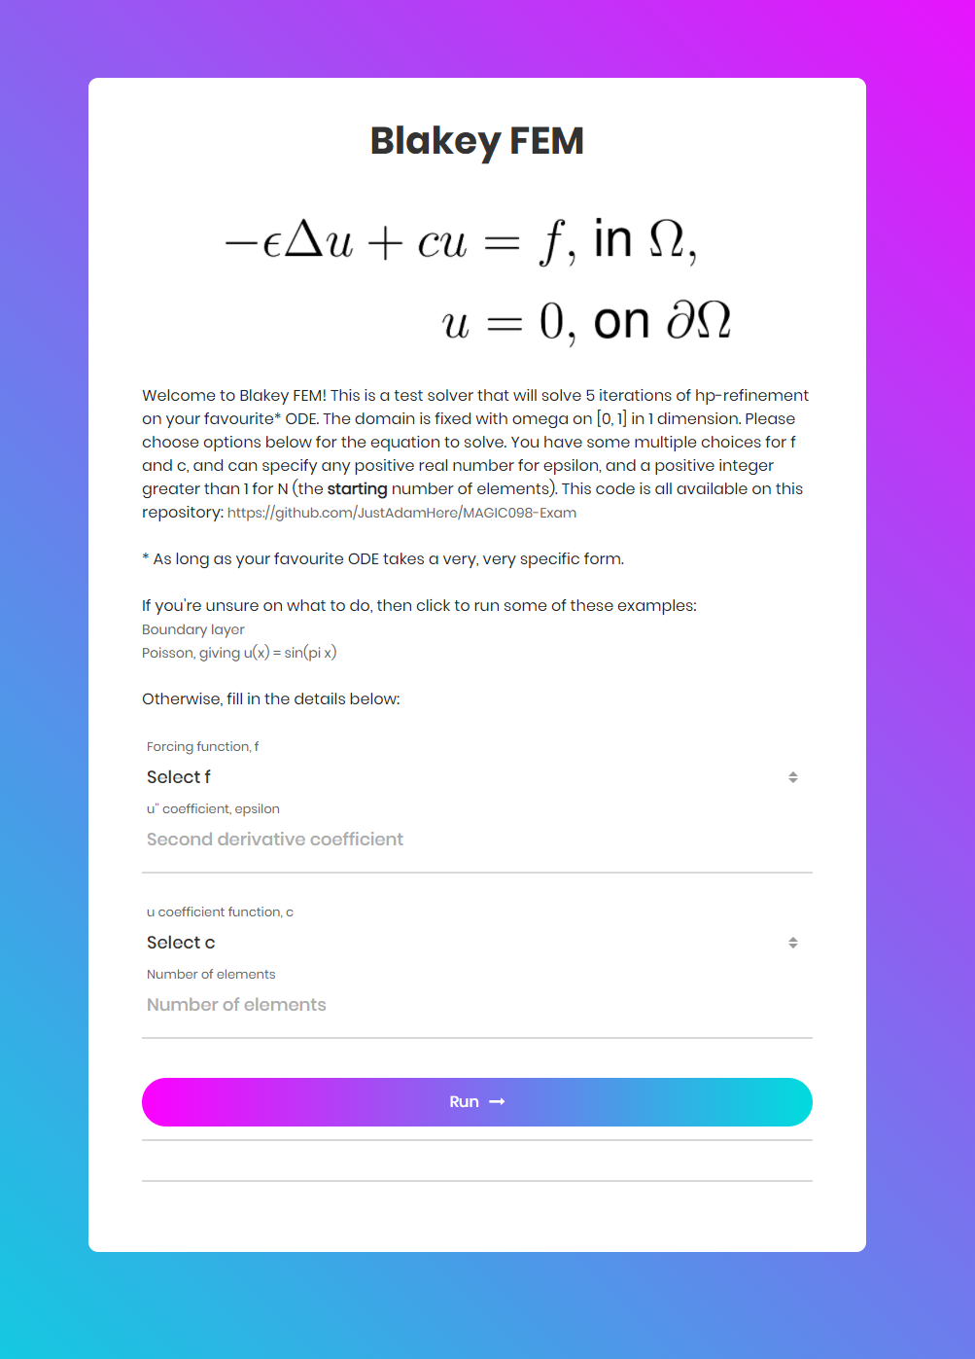

A Quick Snack
A Simple Interactive Example
Go to fem.blakey.family to run the code for yourself!
https://fem.blakey.family

Slide 21
Sorbet
C++ Implementation
Programming Language
Various FEM software packages already exist in a number of languages. We decided to use C++ due to its:
Object-oriented structures
Advanced memory management
Portability
Programming Structure
To make use of the object-oriented paradigm, we split our problem into human-understandable parts:
Mesh
  Elements
Solution
  CG solution
  DG solution
Linear systems
  Matrix storage
  Various linear solvers

Slide 22
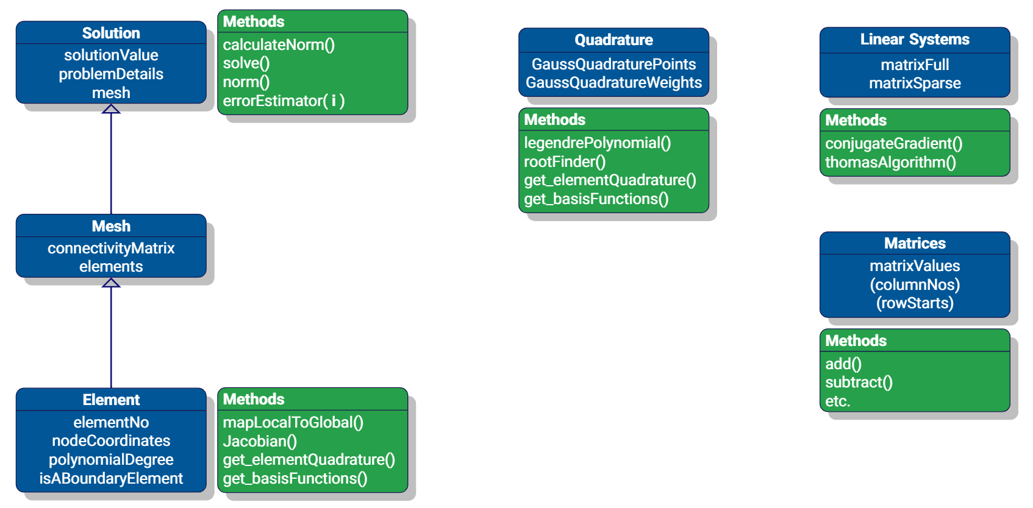
Sorbet
C++ Implementation

Slide 23
Sorbet
C++ Implementation
Primary C++ Ingredients
Linear (and nonlinear) solvers
Quadrature
  Mappings to reference elements
Efficient matrix storage
FEM solvers
Refinement procedures
  Error estimation

Slide 24
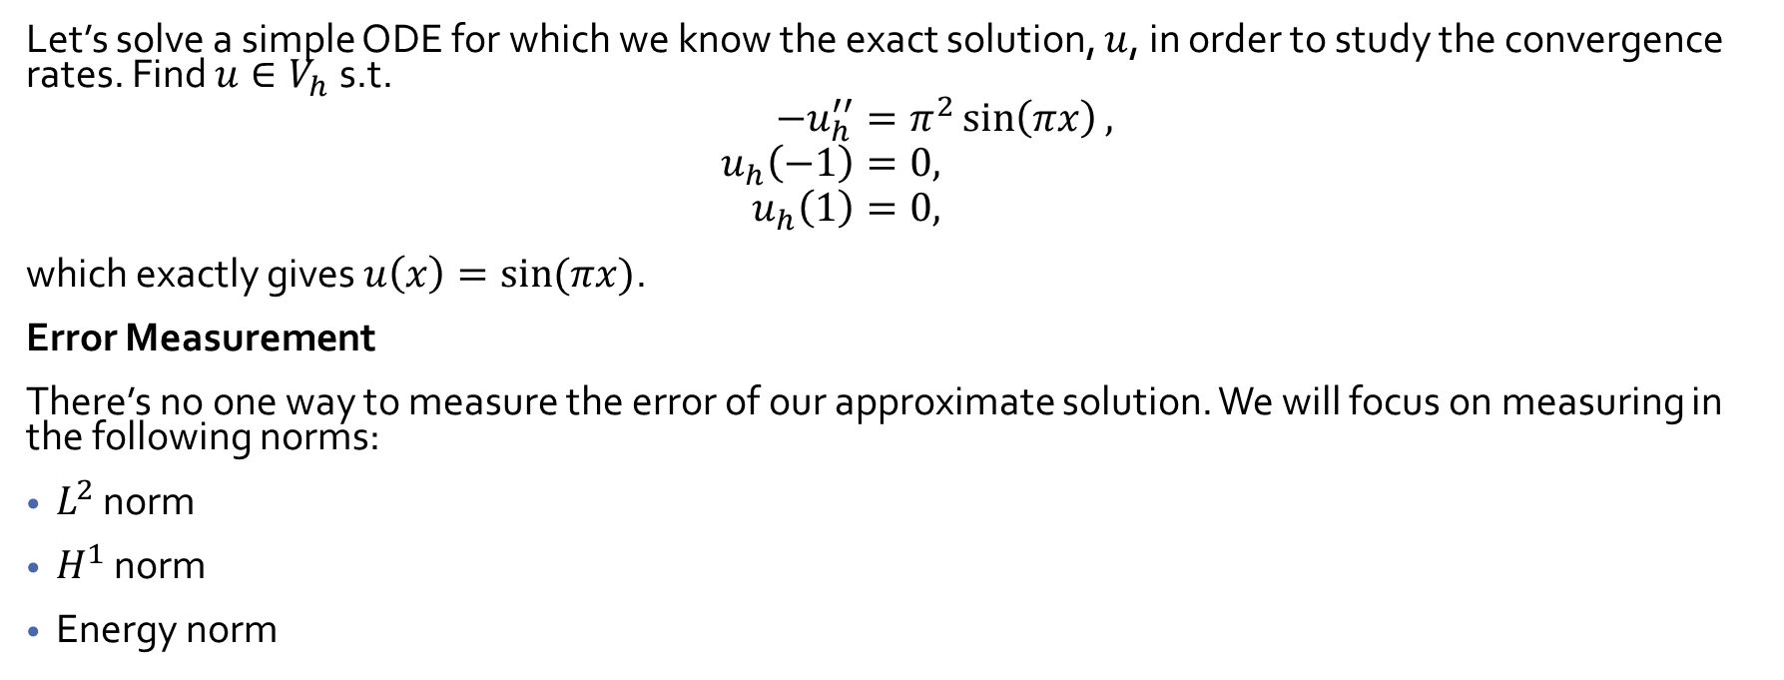
Sorbet
Numerical Experiments
Let’s solve a simple ODE for which we know the exact solution, $u$, in order to study the convergence rates. Find $u∈V_{h}$ s.t.
$$−u_{h}^{′′}=π^{2}\sin\left(πx\right), \\ u_{h}\left(−1\right)=0, \\ u_{h}\left(1\right)=0,$$
which exactly gives $u\left(x\right)=\sin{(πx)}$.
Error Measurement
There’s no one way to measure the error of our approximate solution. We will focus on measuring in the following norms:
$L^{2}$ norm
$H^{1}$ norm
Energy norm

Slide 25
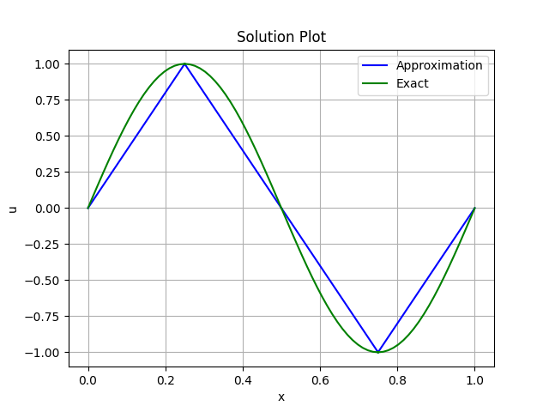
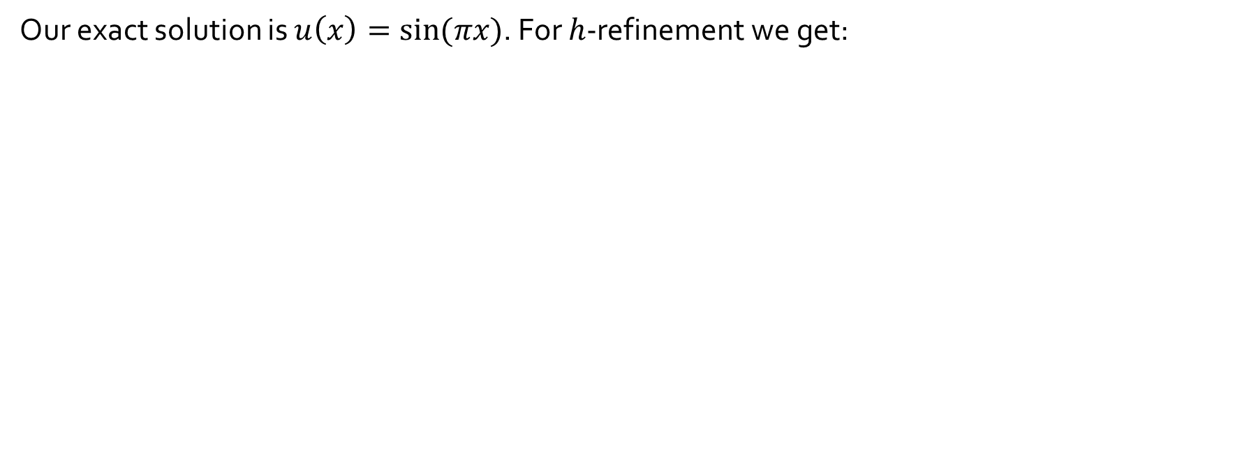
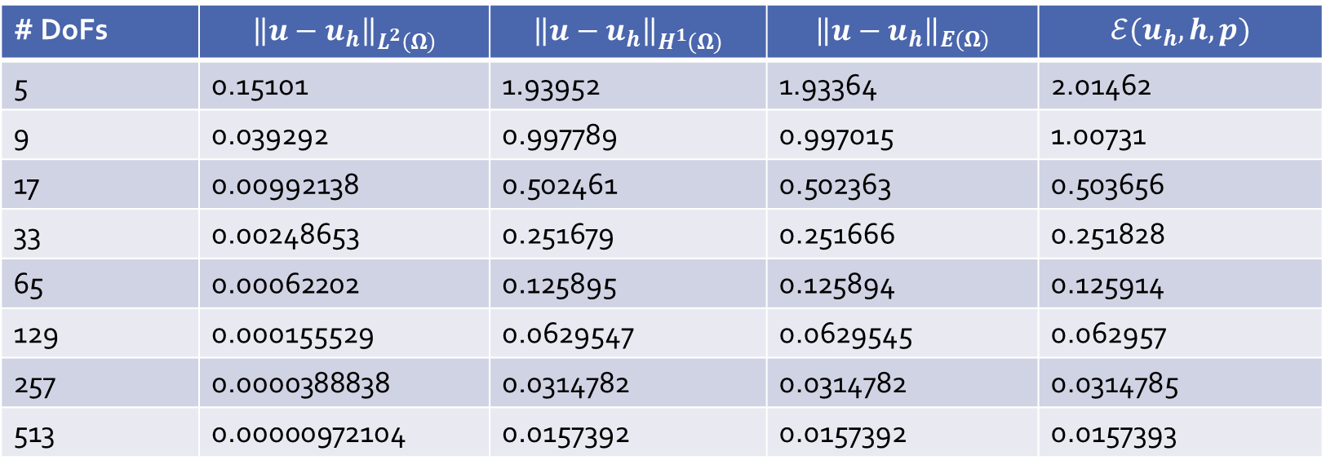
Sorbet
Numerical Experiments
Our exact solution is $u\left(x\right)=\sin{(πx)}$. For $h$-refinement we get:
# DoFs | $${\left\|u−u_{h}\right\|}_{L^{2}\left(Ω\right)}$$ | $${\left\|u−u_{h}\right\|}_{H^{1}(Ω)}$$ | $${\left\|u−u_{h}\right\|}_{E(Ω)}$$ | $$ℰ(u_{h}, h, p)$$
5 | 0.15101 | 1.93952 | 1.93364 | 2.01462
9 | 0.039292 | 0.997789 | 0.997015 | 1.00731
17 | 0.00992138 | 0.502461 | 0.502363 | 0.503656
33 | 0.00248653 | 0.251679 | 0.251666 | 0.251828
65 | 0.00062202 | 0.125895 | 0.125894 | 0.125914
129 | 0.000155529 | 0.0629547 | 0.0629545 | 0.062957
257 | 0.0000388838 | 0.0314782 | 0.0314782 | 0.0314785
513 | 0.00000972104 | 0.0157392 | 0.0157392 | 0.0157393

Slide 26
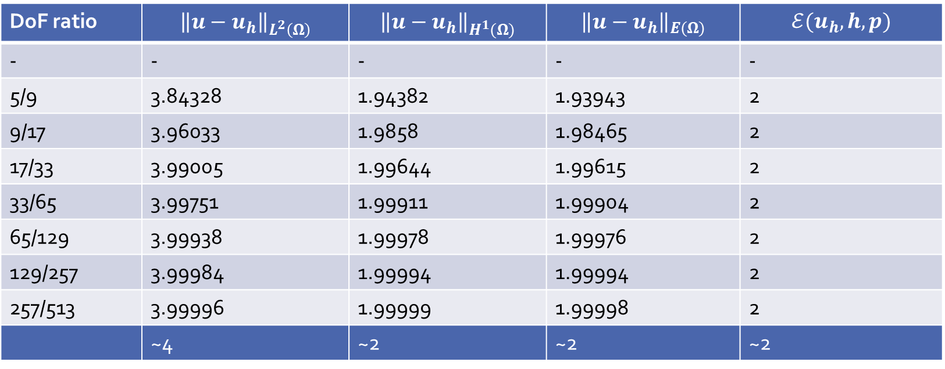
Sorbet
Numerical Experiments
Our exact solution is $u\left(x\right)=\sin{(πx)}$. For $h$-refinement we get:
DoF ratio | $${\left\|u−u_{h}\right\|}_{L^{2}\left(Ω\right)}$$ | $${\left\|u−u_{h}\right\|}_{H^{1}(Ω)}$$ | $${\left\|u−u_{h}\right\|}_{E(Ω)}$$ | $$ℰ(u_{h}, h, p)$$
- | - | - | - | -
5/9 | 3.84328 | 1.94382 | 1.93943 | 2
9/17 | 3.96033 | 1.9858 | 1.98465 | 2
17/33 | 3.99005 | 1.99644 | 1.99615 | 2
33/65 | 3.99751 | 1.99911 | 1.99904 | 2
65/129 | 3.99938 | 1.99978 | 1.99976 | 2
129/257 | 3.99984 | 1.99994 | 1.99994 | 2
257/513 | 3.99996 | 1.99999 | 1.99998 | 2
 | ~4 | ~2 | ~2 | ~2

Slide 27
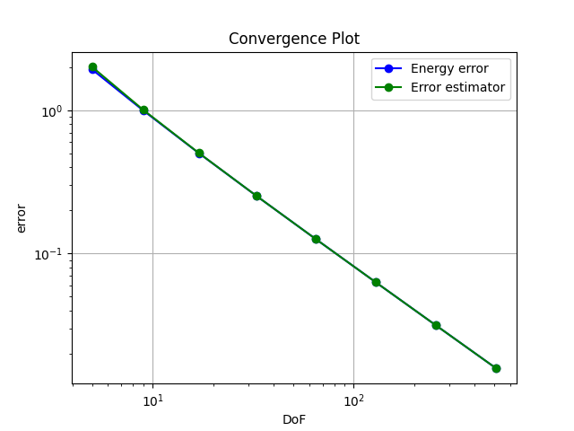
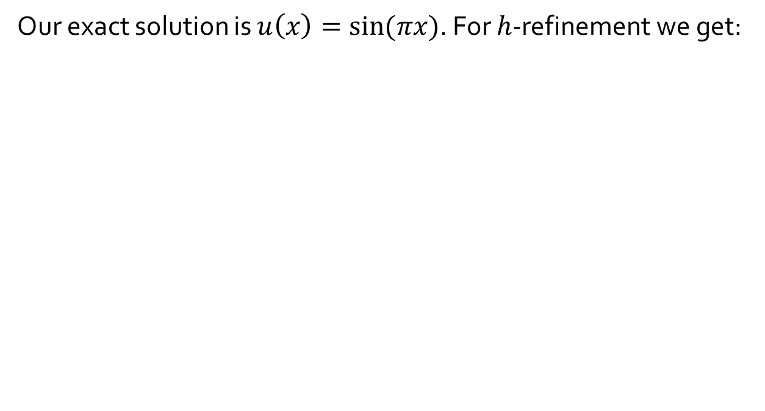

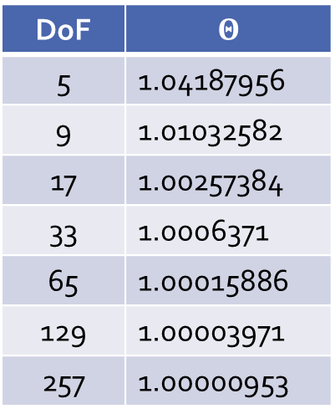
Sorbet
Numerical Experiments
Our exact solution is $u\left(x\right)=\sin{(πx)}$. For $h$-refinement we get:
Efficiency index
$$Θ≔\frac{ℰ(u_{h}, h, p)}{{\left\|u−u_{h}\right\|}_{E}}$$
DoF | $$Θ$$
5 | 1.04187956
9 | 1.01032582
17 | 1.00257384
33 | 1.0006371
65 | 1.00015886
129 | 1.00003971
257 | 1.00000953

Slide 28
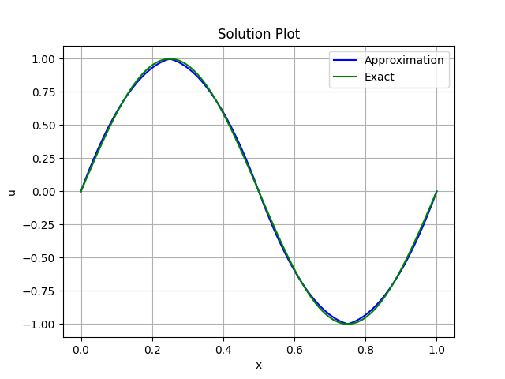
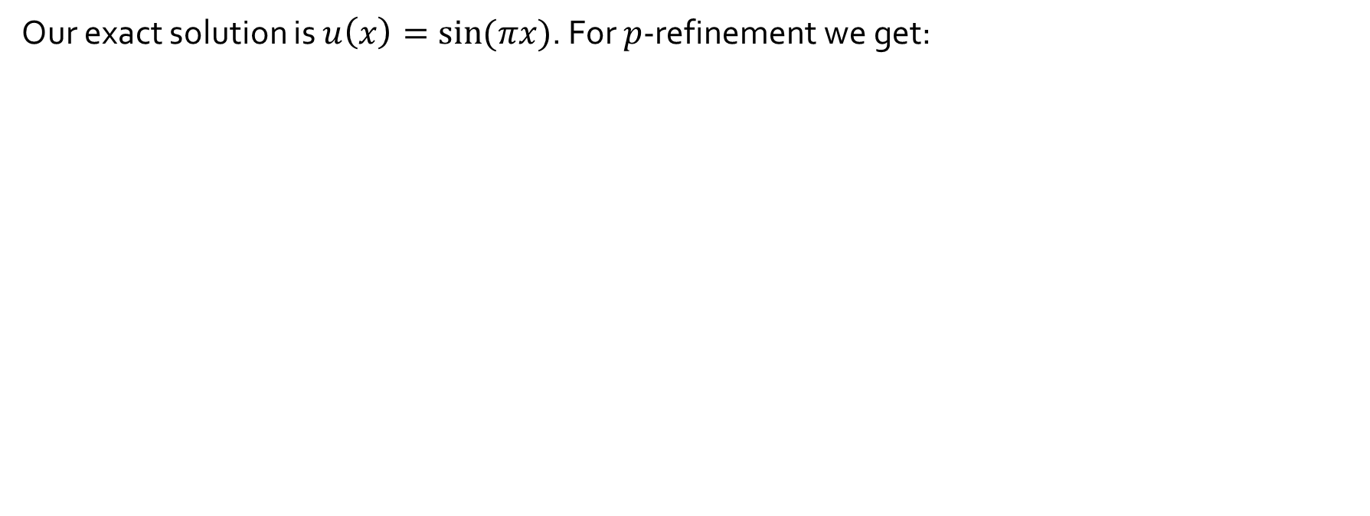
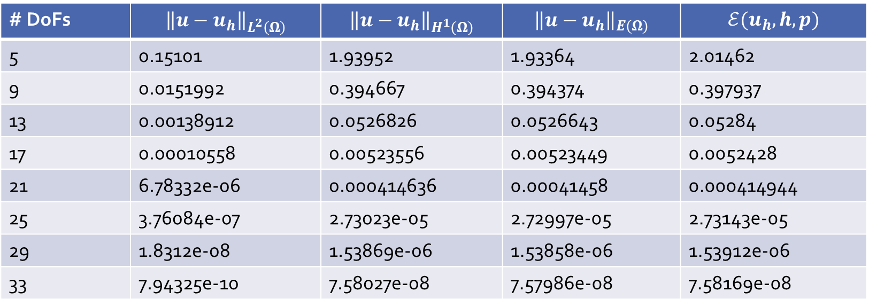
Sorbet
Numerical Experiments
Our exact solution is $u\left(x\right)=\sin{(πx)}$. For $p$-refinement we get:
# DoFs | $${\left\|u−u_{h}\right\|}_{L^{2}\left(Ω\right)}$$ | $${\left\|u−u_{h}\right\|}_{H^{1}(Ω)}$$ | $${\left\|u−u_{h}\right\|}_{E(Ω)}$$ | $$ℰ(u_{h}, h, p)$$
5 | 0.15101 | 1.93952 | 1.93364 | 2.01462
9 | 0.0151992 | 0.394667 | 0.394374 | 0.397937
13 | 0.00138912 | 0.0526826 | 0.0526643 | 0.05284
17 | 0.00010558 | 0.00523556 | 0.00523449 | 0.0052428
21 | 6.78332e-06 | 0.000414636 | 0.00041458 | 0.000414944
25 | 3.76084e-07 | 2.73023e-05 | 2.72997e-05 | 2.73143e-05
29 | 1.8312e-08 | 1.53869e-06 | 1.53858e-06 | 1.53912e-06
33 | 7.94325e-10 | 7.58027e-08 | 7.57986e-08 | 7.58169e-08

Slide 29
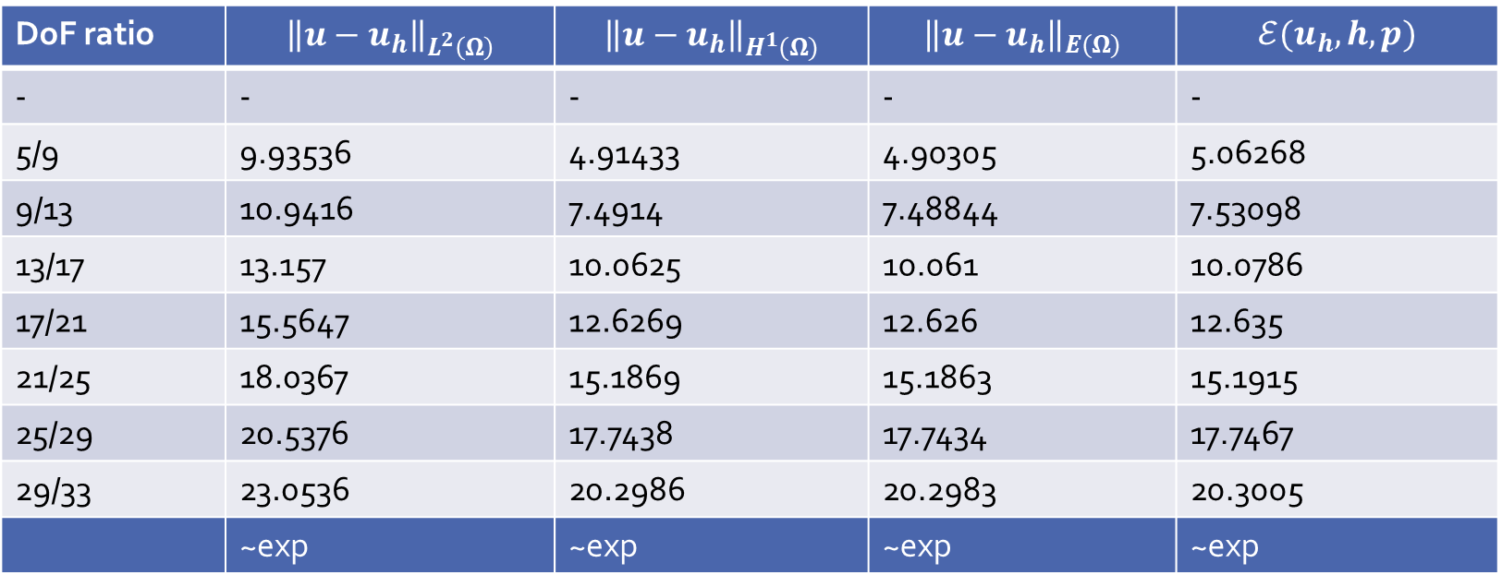
Sorbet
Numerical Experiments
Our exact solution is $u\left(x\right)=\sin{(πx)}$. For $p$-refinement we get:
DoF ratio | $${\left\|u−u_{h}\right\|}_{L^{2}\left(Ω\right)}$$ | $${\left\|u−u_{h}\right\|}_{H^{1}(Ω)}$$ | $${\left\|u−u_{h}\right\|}_{E(Ω)}$$ | $$ℰ(u_{h}, h, p)$$
- | - | - | - | -
5/9 | 9.93536 | 4.91433 | 4.90305 | 5.06268
9/13 | 10.9416 | 7.4914 | 7.48844 | 7.53098
13/17 | 13.157 | 10.0625 | 10.061 | 10.0786
17/21 | 15.5647 | 12.6269 | 12.626 | 12.635
21/25 | 18.0367 | 15.1869 | 15.1863 | 15.1915
25/29 | 20.5376 | 17.7438 | 17.7434 | 17.7467
29/33 | 23.0536 | 20.2986 | 20.2983 | 20.3005
 | ~exp | ~exp | ~exp | ~exp

Slide 30
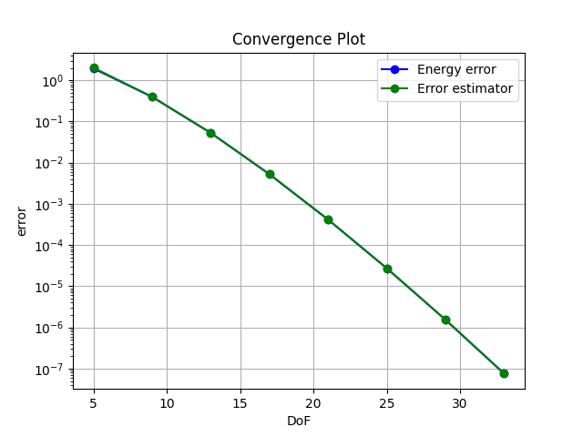
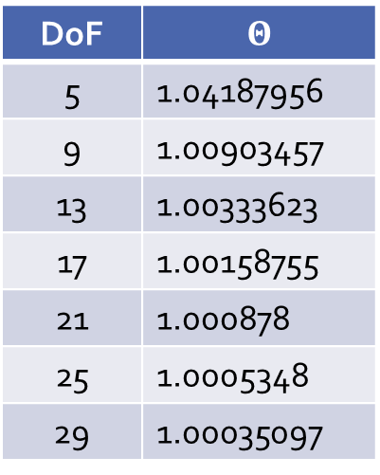
Sorbet
Numerical Experiments
Efficiency index
Our exact solution is $u\left(x\right)=\sin{(πx)}$. For $p$-refinement we get:
$$Θ≔\frac{ℰ(u_{h}, h, p)}{{\left\|u−u_{h}\right\|}_{E}}$$
DoF | $$Θ$$
5 | 1.04187956
9 | 1.00903457
13 | 1.00333623
17 | 1.00158755
21 | 1.000878
25 | 1.0005348
29 | 1.00035097

Slide 31
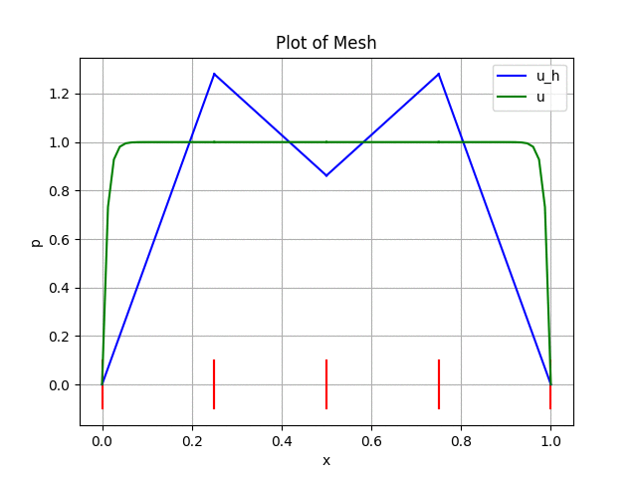
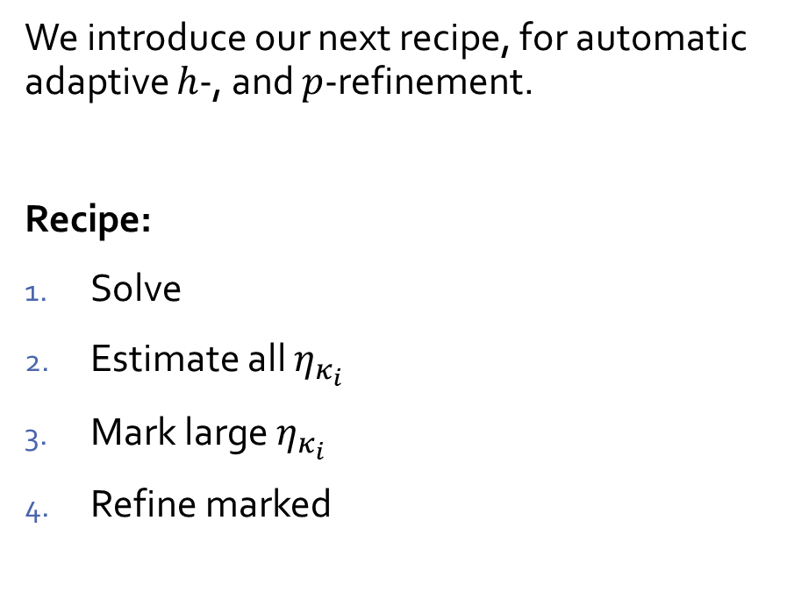

Main Course
$hp$-FEMs in Action
We introduce our next recipe, for automatic adaptive $h$-, and $p$-refinement.
Recipe:
Solve
Estimate all $η_{κ_{i}}$
Mark large $η_{κ_{i}}$
Refine marked

Slide 32
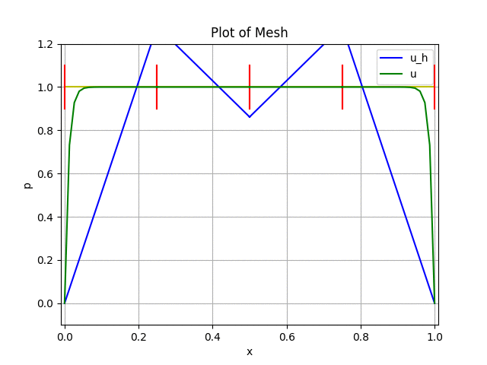
Main Course
$hp$-FEMs in Action
We introduce our next recipe, for automatic adaptive $h$-, and $p$-refinement.
Recipe:
Solve
Estimate all $η_{κ_{i}}$
Mark large $η_{κ_{i}}$
Refine marked
What about $p$-refinement?

Slide 33
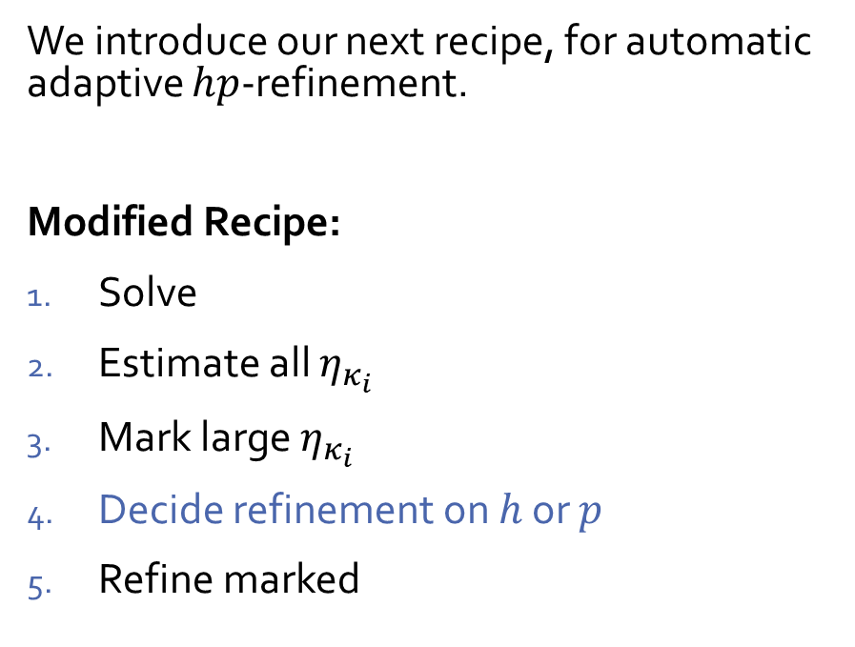
Main Course
$hp$-FEMs in Action
We introduce our next recipe, for automatic adaptive $hp$-refinement.
Modified Recipe:
Solve
Estimate all $η_{κ_{i}}$
Mark large $η_{κ_{i}}$
Decide refinement on $h$ or $p$
Refine marked

Slide 34
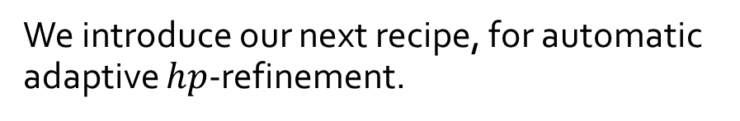
Main Course
$hp$-FEMs in Action
We introduce our next recipe, for automatic adaptive $hp$-refinement.

Slide 35
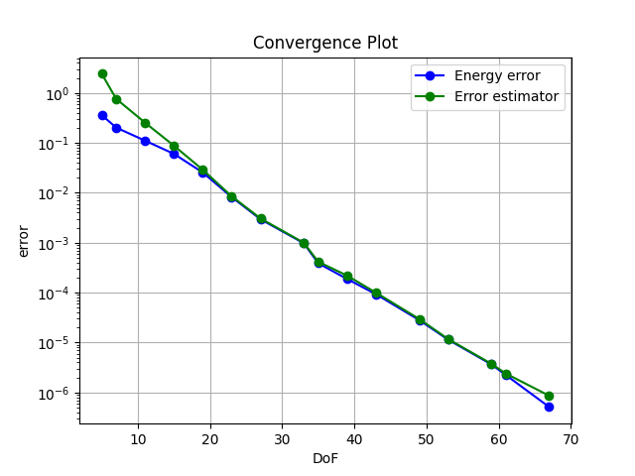
Main Course
$hp$-FEMs in Action
We introduce our next recipe, for automatic adaptive $hp$-refinement.

Slide 36
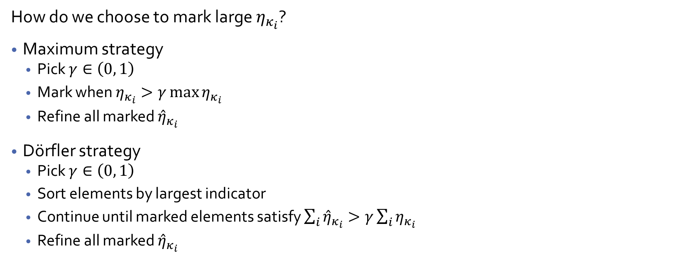
Main Course
$hp$-FEMs in Action
How do we choose to mark large $η_{κ_{i}}$?
Maximum strategy
  Pick $γ∈\left(0, 1\right)$
  Mark when $η_{κ_{i}}>γ\max{η_{κ_{i}}}$
  Refine all marked ${\hat{η}}_{κ_{i}}$
Dörfler strategy
  Pick $γ∈\left(0, 1\right)$
  Sort elements by largest indicator
  Continue until marked elements satisfy $\sum_{i}{{\hat{η}}_{κ_{i}}}>γ\sum_{i}{η_{κ_{i}}}$
  Refine all marked ${\hat{η}}_{κ_{i}}$

Slide 37
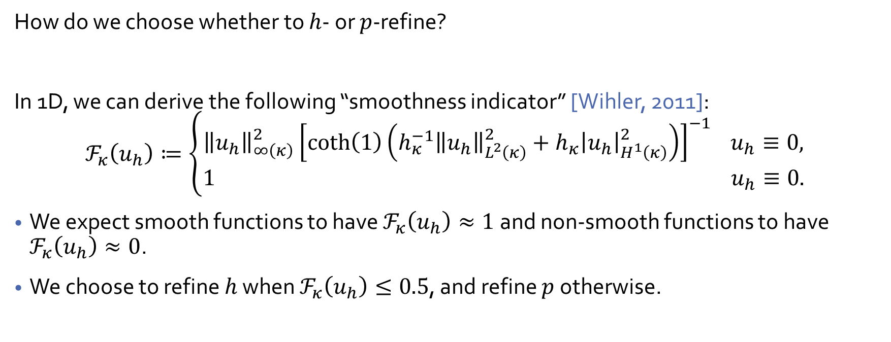
Main Course
$hp$-FEMs in Action
How do we choose whether to $h$- or $p$-refine?
In 1D, we can derive the following “smoothness indicator” [Wihler, 2011]:
$$ℱ_{κ}\left(u_{h}\right)≔\left\{\begin{aligned}{\left\|u_{h}\right\|}_{∞\left(κ\right)}^{2}{\left[\coth\left(1\right)\left(h_{κ}^{−1}{\left\|u_{h}\right\|}_{L^{2}\left(κ\right)}^{2}+h_{κ}{\left|u_{h}\right|}_{H^{1}\left(κ\right)}^{2}\right)\right]}^{−1} u_{h}≡0, \\ 1 { u}_{h}≡0.\end{aligned}\right.$$
We expect smooth functions to have $ℱ_{κ}\left(u_{h}\right)≈1$ and non-smooth functions to have $ℱ_{κ}\left(u_{h}\right)≈0$.
We choose to refine $h$ when $ℱ_{κ}\left(u_{h}\right)≤0.5$, and refine $p$ otherwise.

Slide 38
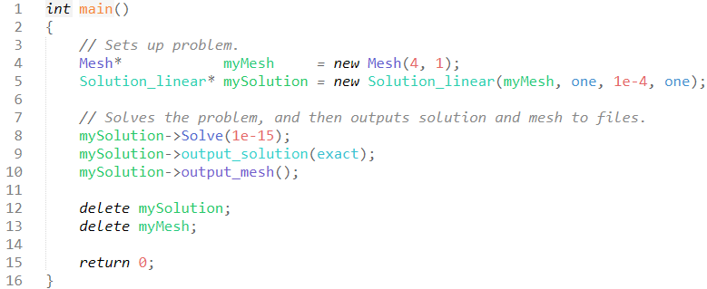
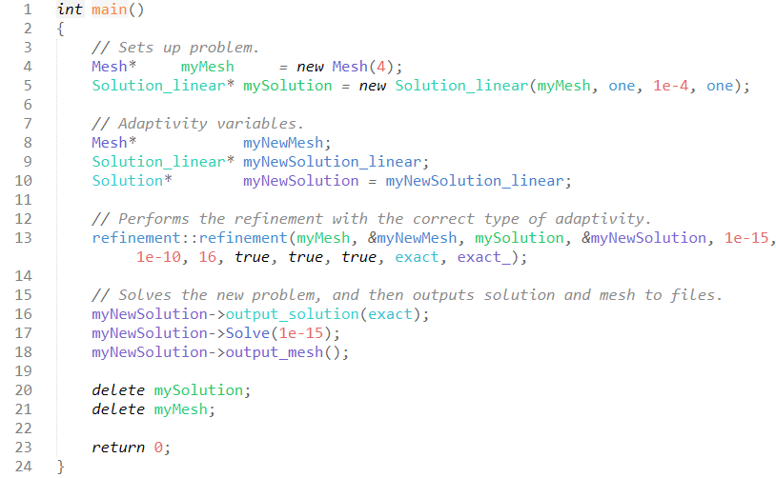

Main Course
$hp$-FEMs in Action
Why was all of that OOP necessary?
Example Boundary Layer Simulation
$hp$-Adaptive Boundary Layer Simulation

Slide 39
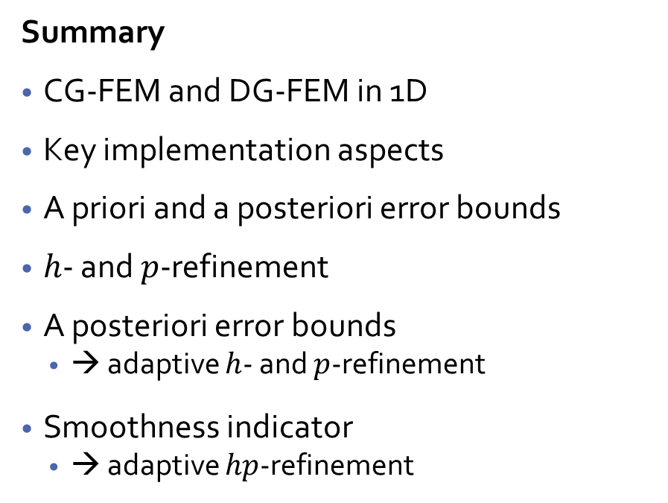
Pudding
$hp$-FEMs in Action
Summary
CG-FEM and DG-FEM in 1D
Key implementation aspects
A priori and a posteriori error bounds
$h$- and $p$-refinement
A posteriori error bounds
  → adaptive $h$- and $p$-refinement
Smoothness indicator
  → adaptive $hp$-refinement
Outlook
Convection-dominated PDEs
Generalisation to 2D and 3D
Time dependant problems
Placentas
  Complicated geometries
  Fluid-structure interaction
Notes:
Placentas:
Blood flow is linked to the in-utero function: hope to compare real MRI data to an in-silico model.
To help with the contrasting situations: type 1 diabetes and pre-eclampsia
Want to create an in-silico test bed for scientists to detect issues early.

