Slide 1
Lights, Camera, Blazor:
Modernising cinema software with C# and Blazor
Adam Blakey (he/him)
Notts Techfast, 2025-07-16

Slide 2
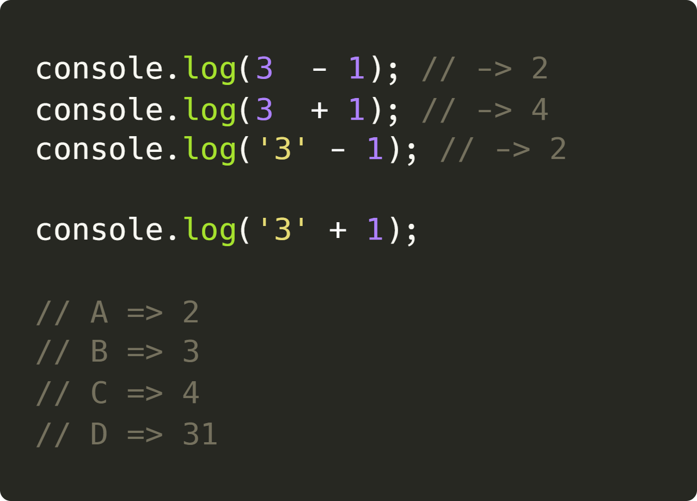
Mildly frustrating: I

Slide 3
Mildly frustrating: I

Slide 4
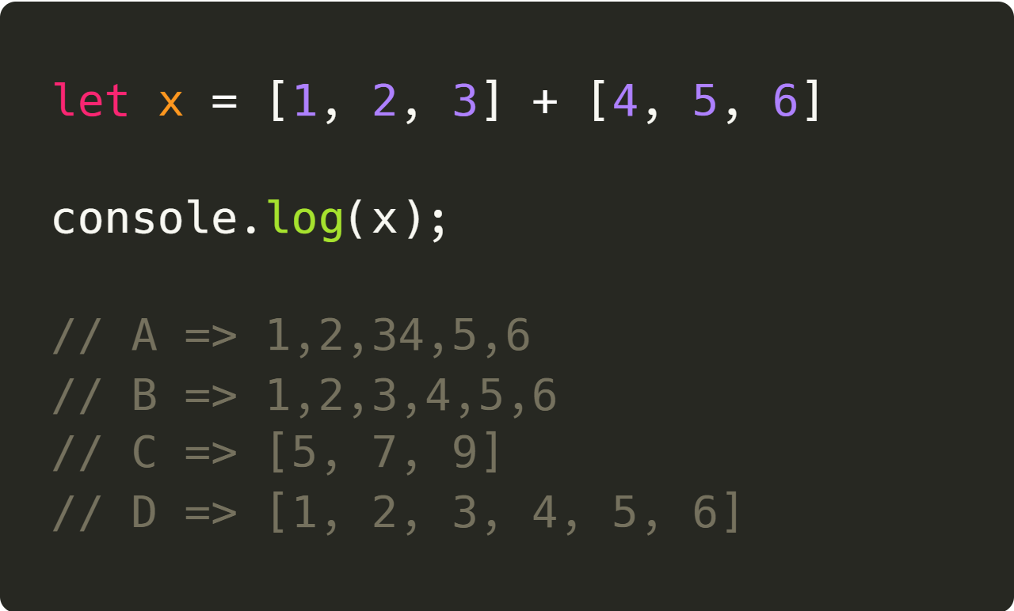
Mildly frustrating: II

Slide 5
Mildly frustrating: II

Slide 6
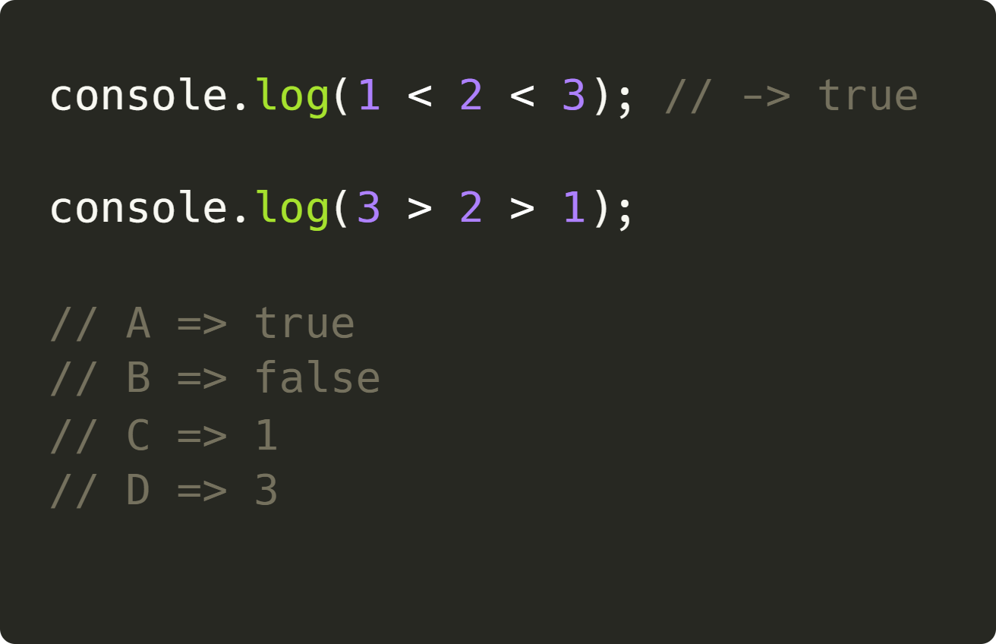
Mildly frustrating: III

Slide 7
Mildly frustrating: III

Slide 8
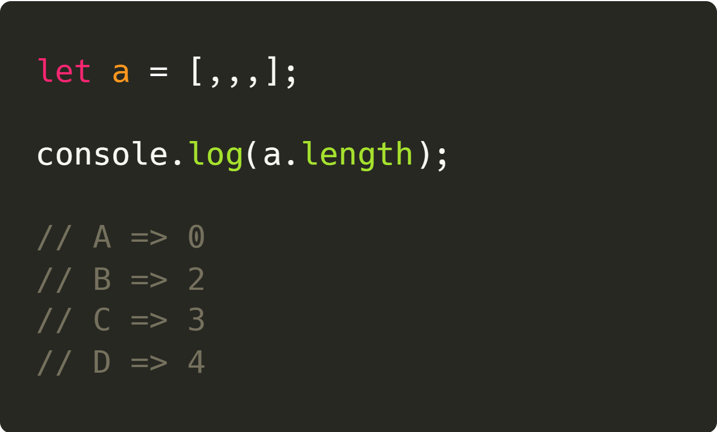
Mildly frustrating: IV

Slide 9
Mildly frustrating: IV

Slide 10
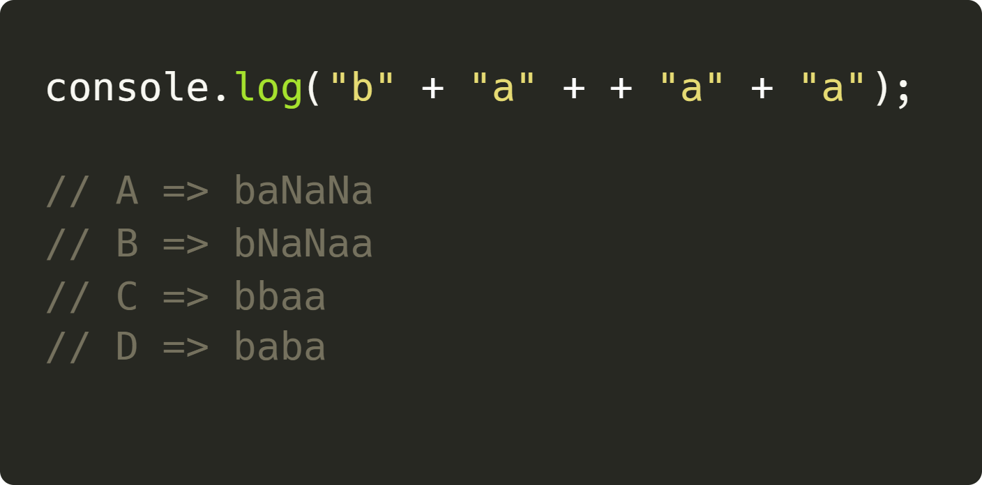
Mildly frustrating: III

Slide 11
Mildly frustrating: III

Slide 12
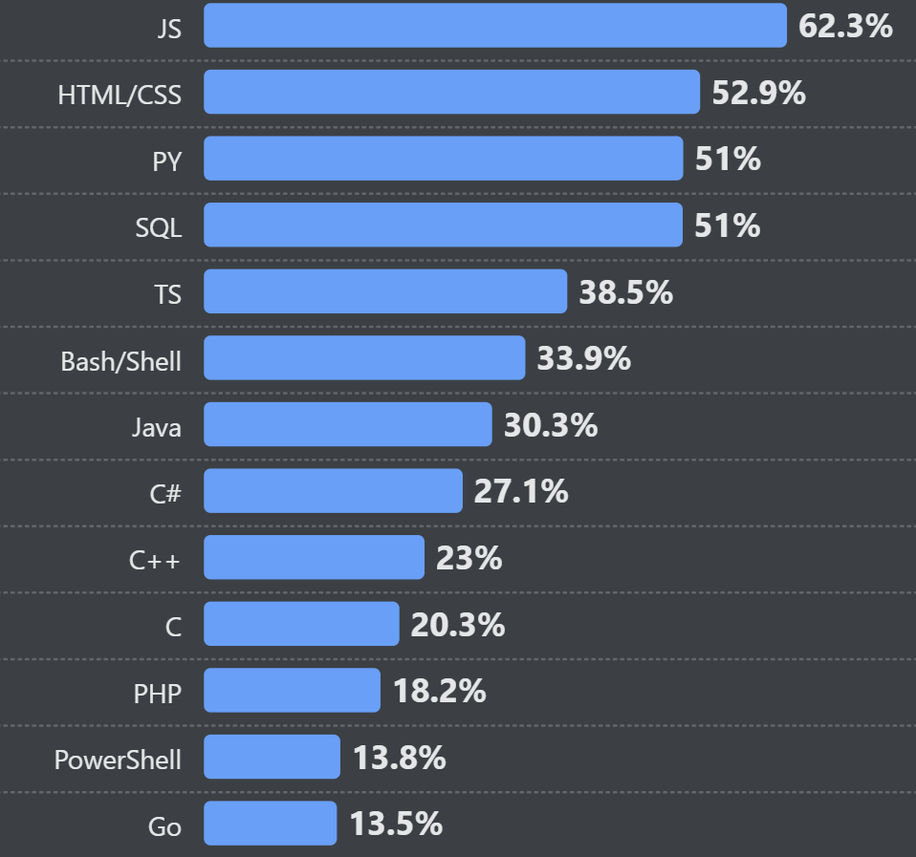
Mildly frustrating
More fun is available: bit.ly/wtfjavascript
Web is instantly cross-platform
Some people avoid JavaScript
  TypeScript
  WebAssembly
[https://survey.stackoverflow.co/2024/technology]
Notes:
Which programming, scripting, and markup languages have you done extensive development work in over the past year, and which do you want to work in over the next year?

Slide 13









Introducing WebAssembly
Runs in browsers
Low-level
Not a replacement to JavaScript
JavaScript, Web, and WASI APIs
Notes:
“portable binary-code format for executing programs”
Easiest way for cross-platform?
WASI: WebAssembly System Interface
W3C: World Wide Web Consortium

Slide 14

Hi, I’m Adam
Adam Blakey (he/him)

Slide 15

Today’s talk
My background
Introduction to Blazor
JavaScript and WebAssembly
Blazor in action
  (Tiny) snippet of Savoy Systems’ work
For the record:
I am not an expert in Blazor or WebAssembly
Notes:
Today’s aims:
Get excited about Blazor
Get excited about WebAssembly

Slide 16



Short background
Monkeying around (pre-2016)
Mathematics PhD (2020)
Mother tongue of PHP
HTML/CSS
Websites for family & friends
Blood flow in the placenta
Fortran & Python
Teaching
Mathematics MMath (2016)
Savoy Systems (2024)
Focus on scientific computation
MATLAB & C++
Ticketing software
Delphi & C#
Blazor!
2025-07-16

Slide 17
2. Blazor

Slide 18
A brief history of interactive web apps
Web 1.0
Mostly static
HTML/PHP/ASP
JavaScript (1995)
Single-page apps
e.g., AngularJS, Backbone.js
WebAssembly released
Chrome, Edge, Firefox, and WebKit
Browser execution
Blazor released
Officially supported
WebAssembly
2010-ish
2017
2020
1990s
2000s
2013–2016
2018
Interactivity
e.g., AJAX, jQuery, Silverlight, Flash
Modern frameworks
e.g., React, Vue.js
Blazor experiment
Unofficial project
Blazor =
“Browser” + “Razor”
Notes:
Web 1.0
ASP: Active Server Pages
JavaScript:
“language for the masses”
Originally called LiveScript
Marketing ploy for popular Java language

Slide 19

What is Blazor?
Web framework
SPA
Uses Razor
Hosting models:
  Blazor Web app (Server)
    Static
    Interactive server
    Interactive WebAssembly
    Interactive auto
  WebAssembly (Client)
  Hybrid (e.g., .NET MAUI)
Notes:
Web frameworks
Laravel (PHP)
Ruby on Rails
Blazor Web app (Server)
Static
Interactive server (~ thin client)
Interactive WebAssembly <- loading issue
Interactive auto
PWA
MAUI: Multi-platform App UI

Slide 20
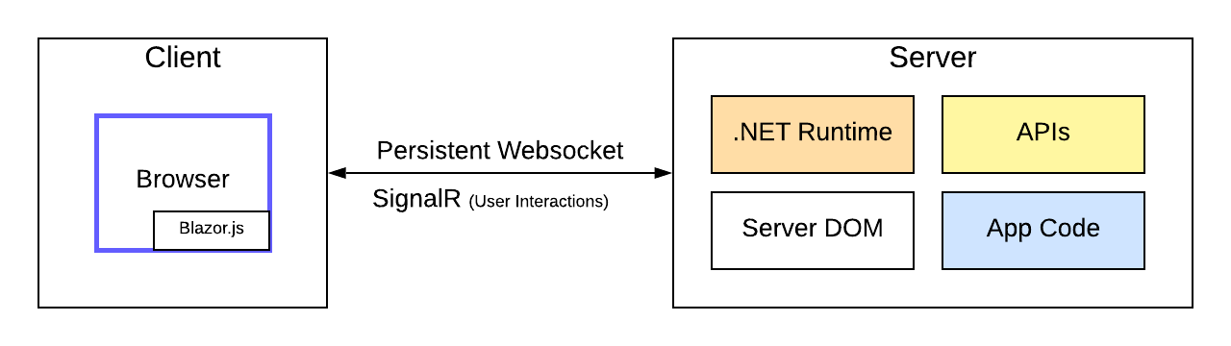
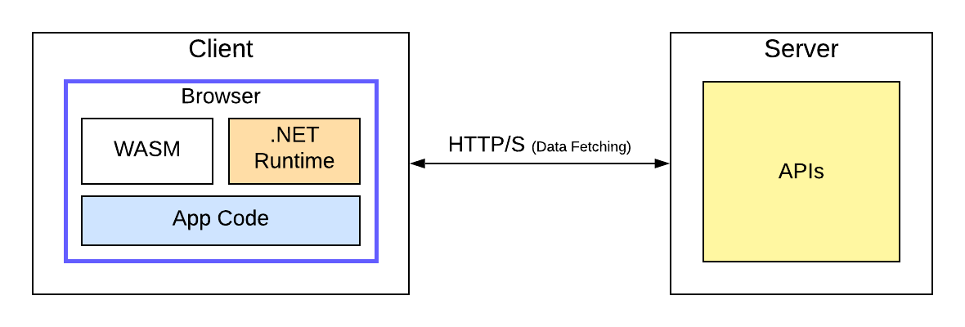
Some details
Components are .NET classes
Binding parameters
JavaScript interop
SignalR
[images from https://www.telerik.com/]
Notes:
SignalR:
Abstract communication
WebSockets
Server-sent events
Long polling
Hubs
JavaScript
Bi-direction calling

Slide 21
Some details
Components are .NET classes
Binding parameters
JavaScript interop
SignalR
[images from https://www.telerik.com/]
Notes:
SignalR:
Abstract communication
WebSockets
Server-sent events
Long polling
Hubs
JavaScript
Bi-direction calling

Slide 22
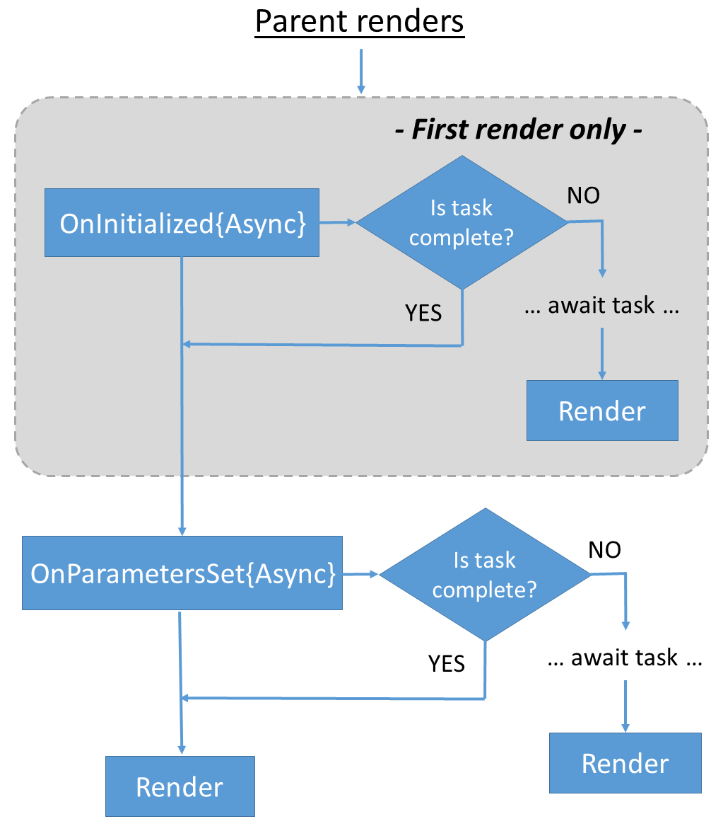
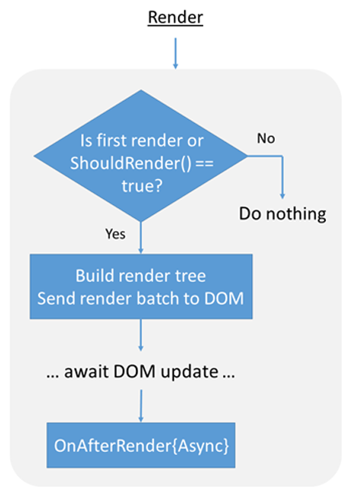
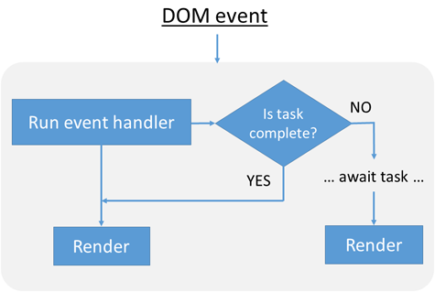
Blazor lifecycle
[https://learn.microsoft.com/]

Slide 23
Keen?
https://dotnetcore.show/
https://blazor-university.com/
https://learn.microsoft.com
https://dotnet.microsoft.com/en-us/learn/aspnet/blazor-tutorial/intro
https://blog.stevensanderson.com/2018/02/06/blazor-intro/
Google, obvs

Slide 24
3. WebAssembly

Slide 25
WebAssembly
Client-side computation
More locked-down than JavaScript
JavaScript for non-intensive tasks
Figma, Ebay (barcode scanning), WordPress Playground, Photoshop (beta), BBC iPlayer (soon?)
[more at https://web.dev and https://madewithwebassembly.com]
Notes:
More locked-down than JavaScript
No DOM access

Slide 26
Use WebAssembly
Ada
AssemblyScript
C/C++
C#
Cobol
D
Dart
F#
Go
Grain
Haskell
Java
Kotlin
Lua
Moonbit
Pascal
PHP
Python
R
RemObjects Elements
Ruby
Rust
Scala.js
Scheme
Swift
Zig
[https://webassembly.org/getting-started/developers-guide/]

Slide 27
4. Demos

Slide 28

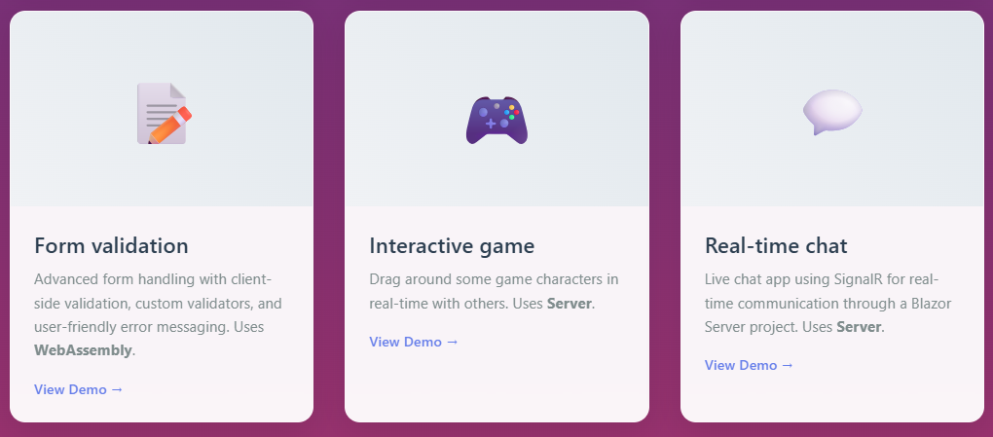
Demos
https://techfast.blakey.family

Slide 29
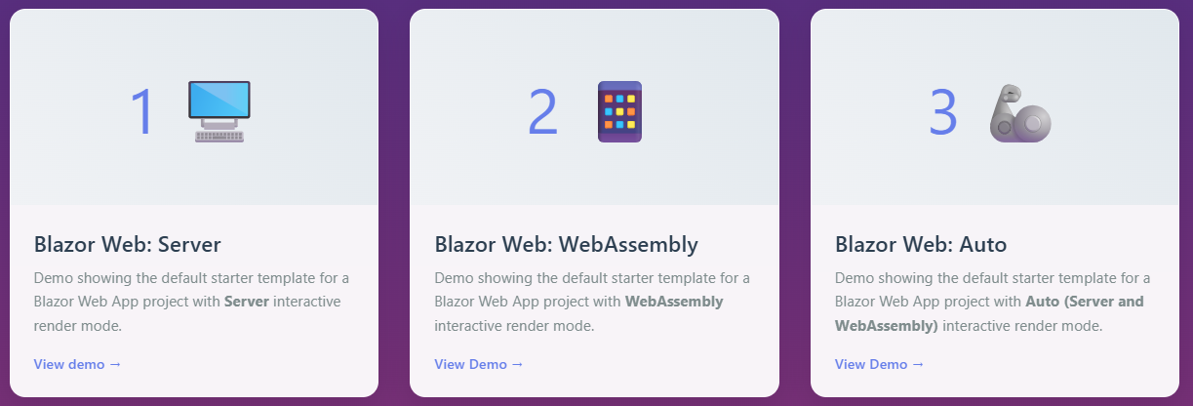
Demos 1—3
https://techfast.blakey.family
Default app x3
Server offline
File sizes

Slide 30
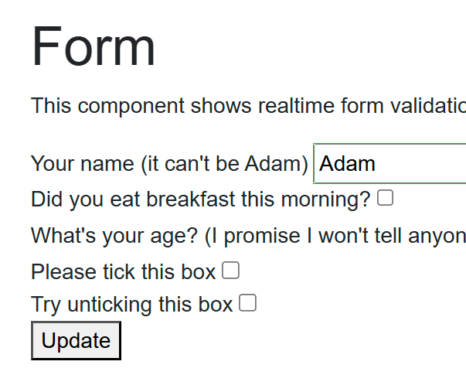
Demo 4
https://techfast.blakey.family
Silly form validation
Entirely client-side in WASM
Bound checkboxes

Slide 31
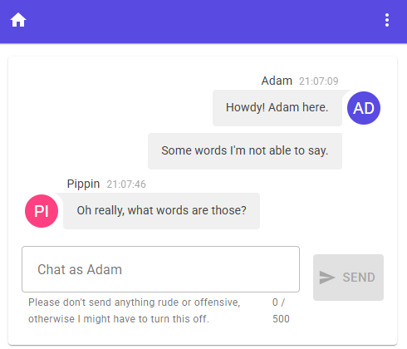
Demo 5
https://techfast.blakey.family
Features
  Real-time chat
  Event handlers in Singleton C# web server service
  Client-side browser storage
Packages
  MudBlazor
  Blazored.LocalStorage
  Profanity.Detector
  morelinq

Slide 32

Demo 6
https://techfast.blakey.family
Features
  SignalR hubs
  MouseUp
  Simple CSS transformations
  No persistence

Slide 33
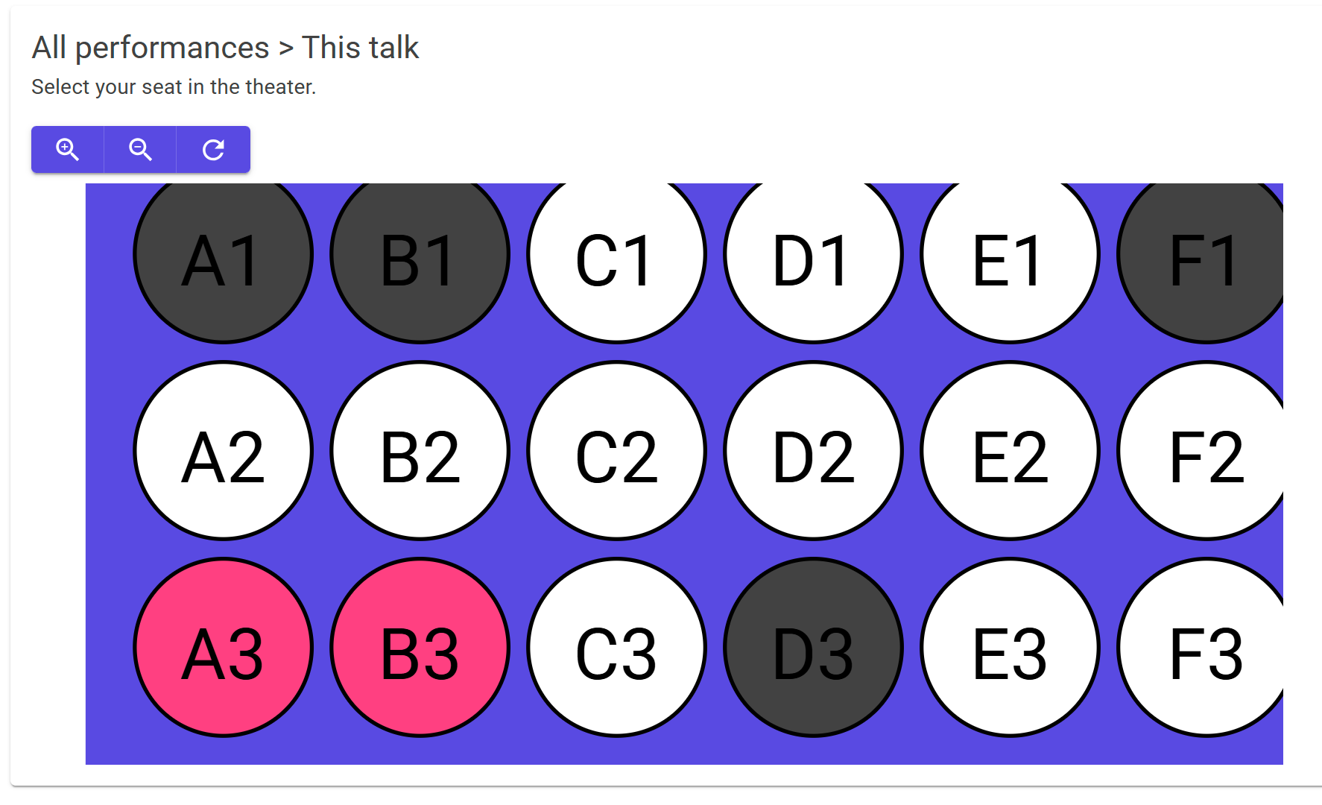
Demo 7
https://techfast.blakey.family
Features
  Select seat in real-time
  Clicking, dragging, and zooming
  No persistence

Slide 34
Demo summary
https://techfast.blakey.family
Hosting models
Data binding
Entirely WASM apps
Rich package availability
Real-time via event handlers & SignalR

Slide 35
In summary
Blazor is pretty cool
  Interactive C# web apps
WebAssembly is pretty cool
  Client-side byte-code

Slide 36



Adam Blakey
https://adam.blakey.family
adam.blakey.family
/adamblakey

Slide 37
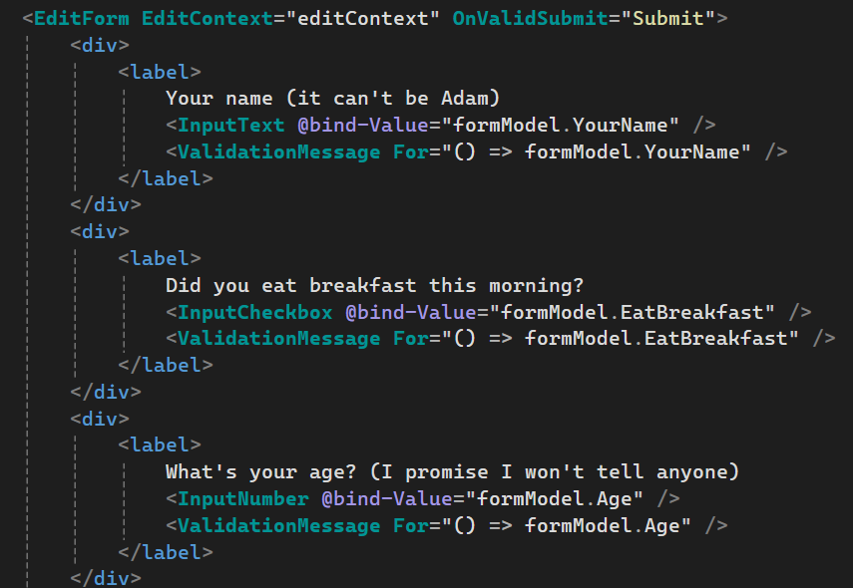
Form code

Slide 38
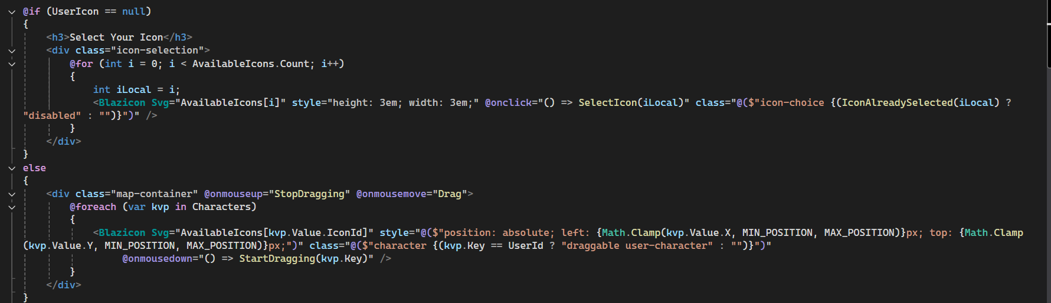
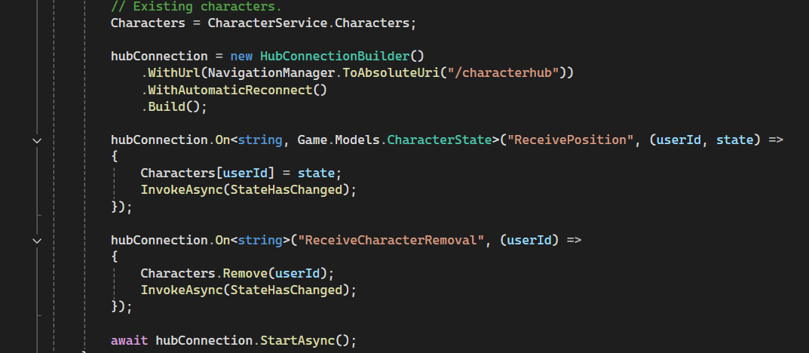
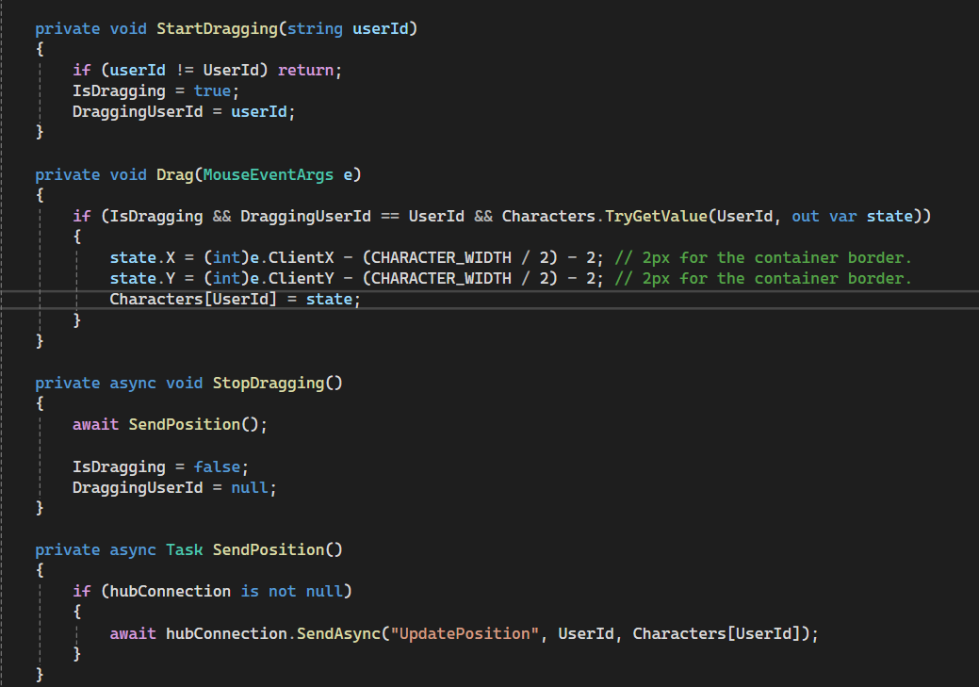
Game code

